Slide 1
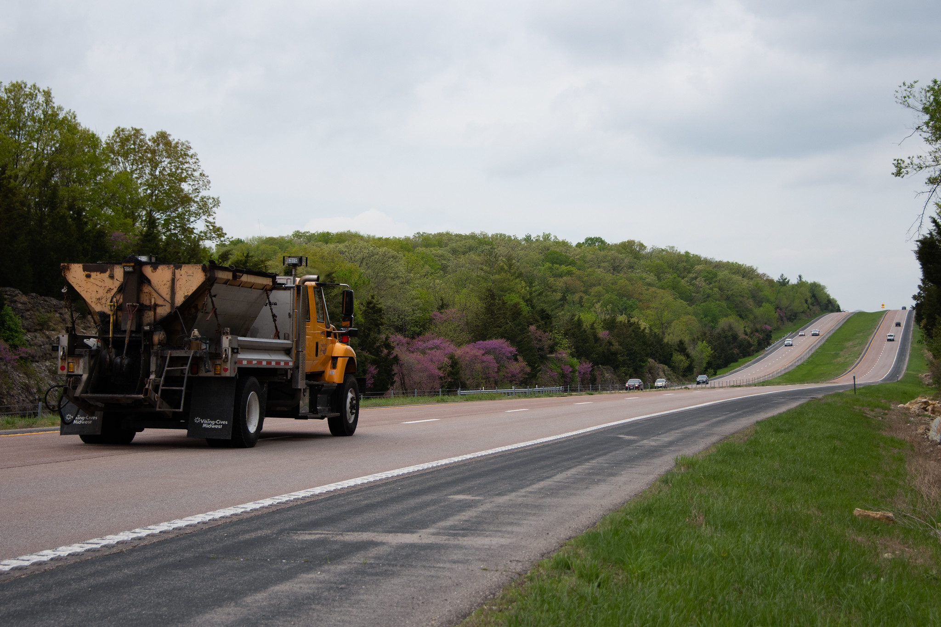
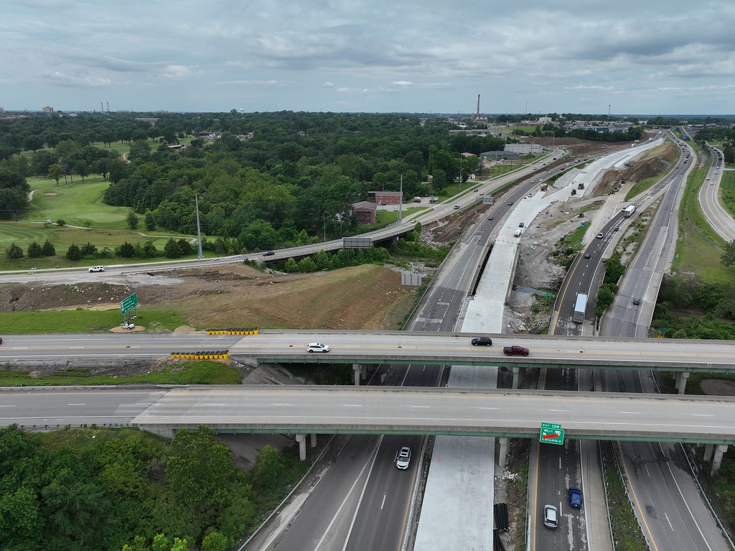
MoDOT UPDATE
Mark Croarkin
Assistant Chief Engineer

Slide 2

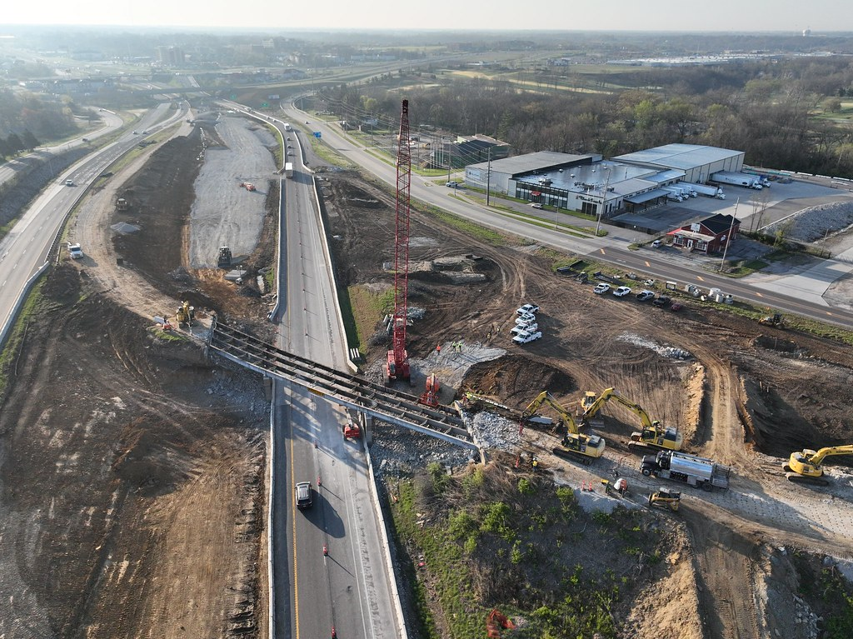
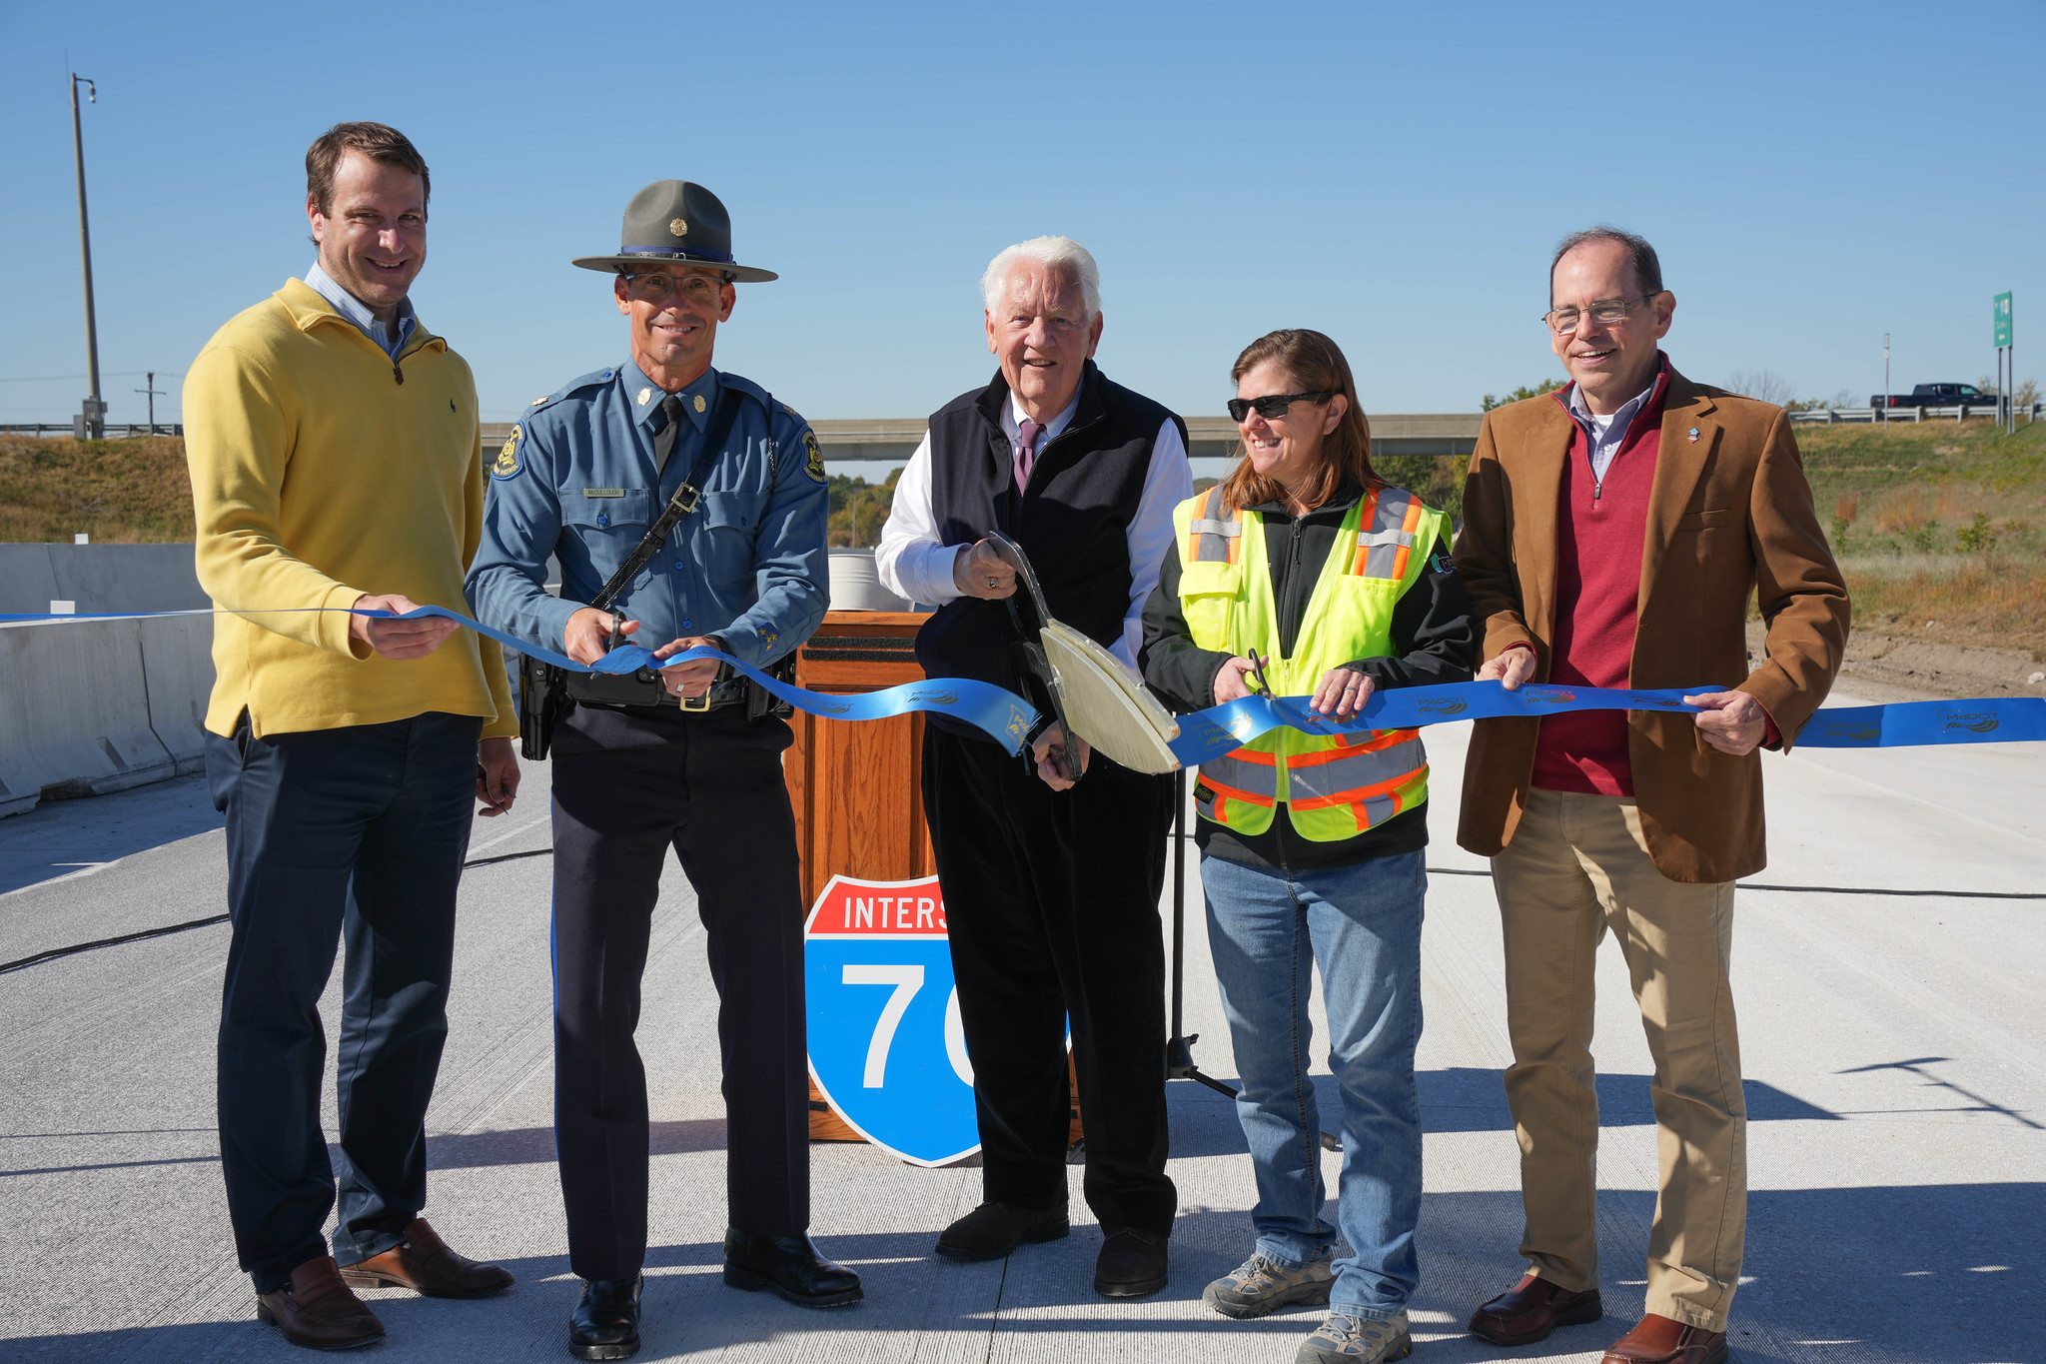
A SUCCESSFUL PARTNERSHIP
4,000+ projects worth nearly $10 billion delivered in the last decade​
Innovative problem-solving: ​
  Value engineering​
  Design-Build

Slide 3
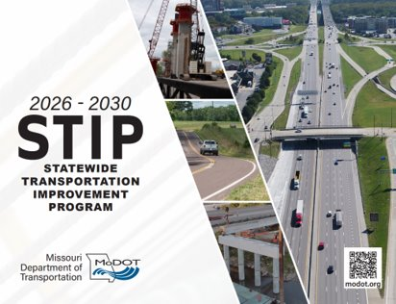
LOOKING AHEAD
One of Missouri’s largest programs to date​
  $13.3 billion
  $9.5 billion in road and ​bridge
  construction​​
  $1.1 billion in multimodal​
  1,200+ projects​
2027-2031 STIP development kicking off this month

Slide 4
2026-2030 STIP COMPARISON
CONTRACTOR AWARDS

Slide 5
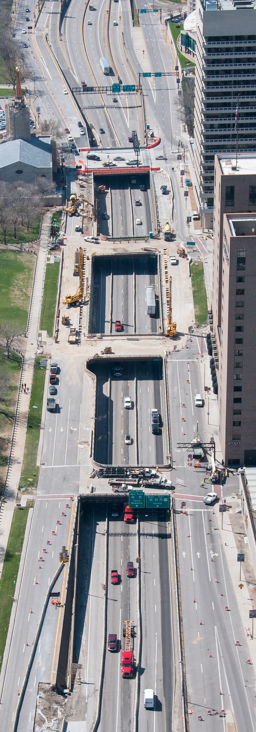
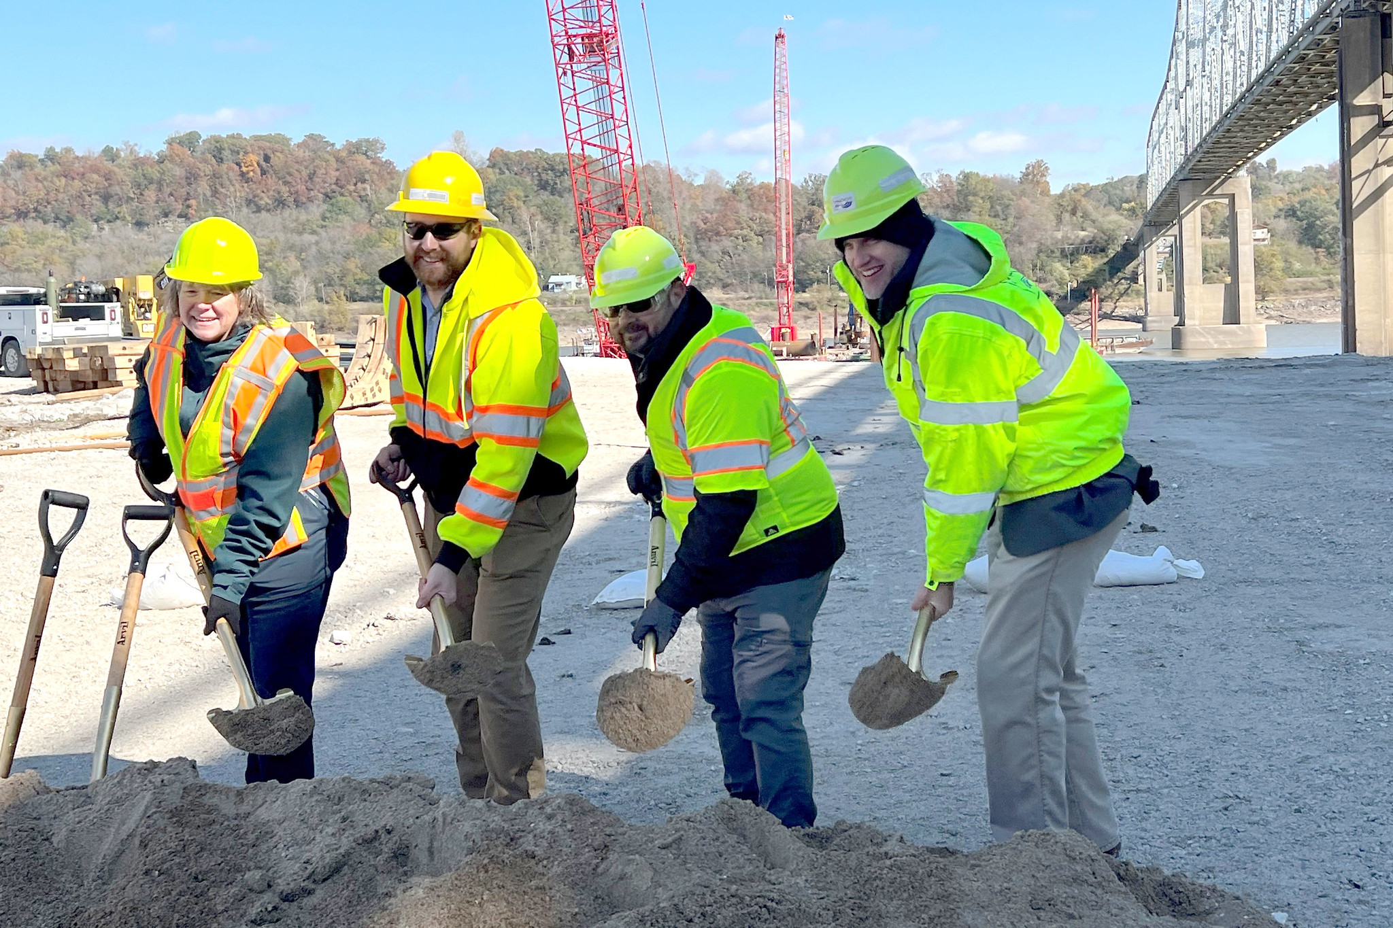
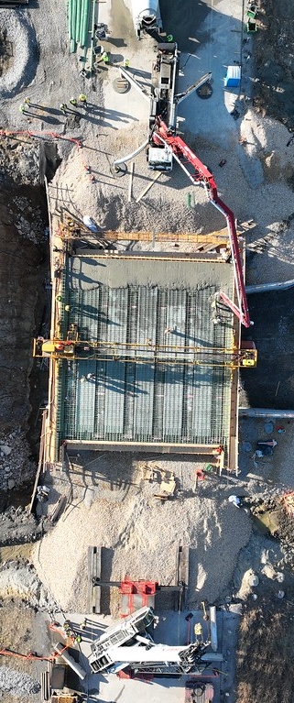
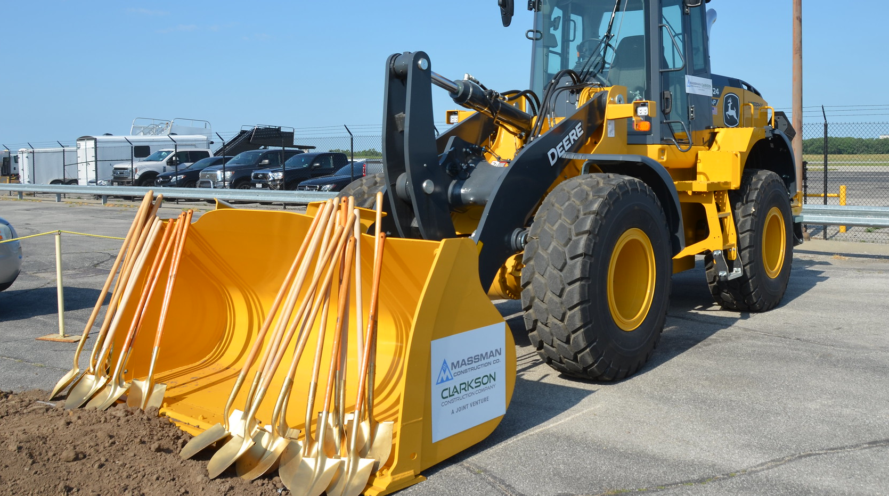
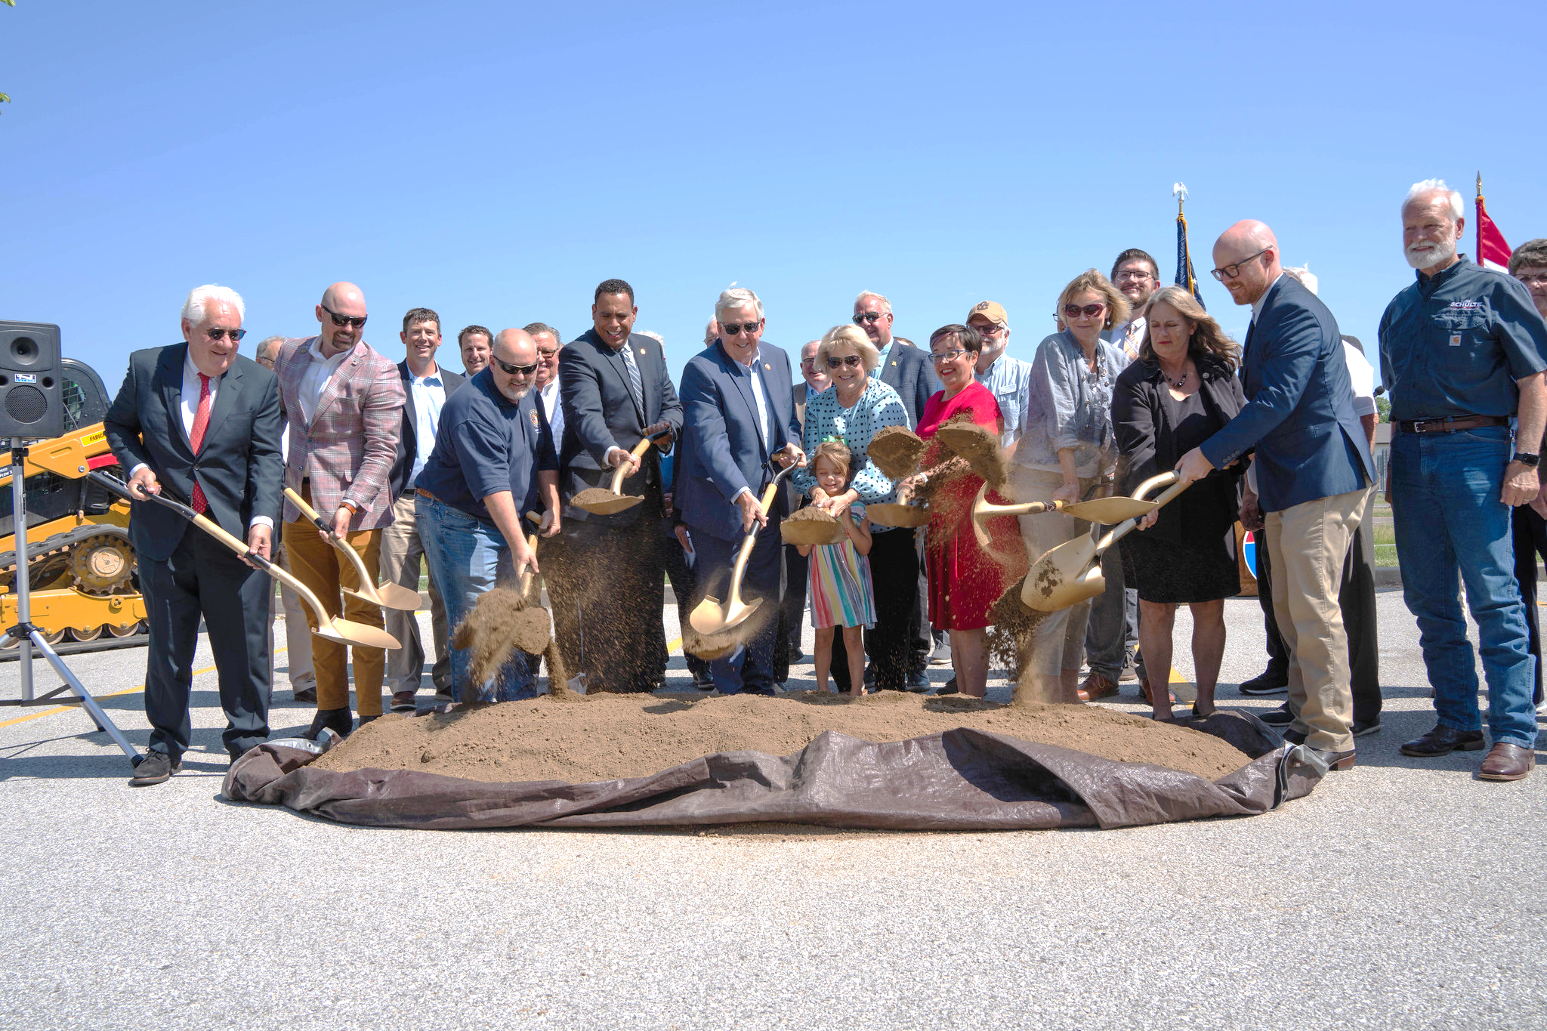
THEN & NOW
10 years ago:
  20 projects over $25 million
Today:
  50 projects over $25 million

Slide 6
STIP OVERVIEW
Asset Management vs Capital Improvement​
Category | 2026-2030 STIP
Asset Management | 82%
Capital Improvement | 12%
Other | 6%
Pavement (miles)
Bridges (number)
Category | 2026-2030 STIP
Interstate/Major | 5,785
Minor | 6,301
Low Volume | 463
Total | 12,549
Category | 2026-2030 STIP
Typical Bridge | 904
Major Bridge | 125
Total | 1,029

Slide 7
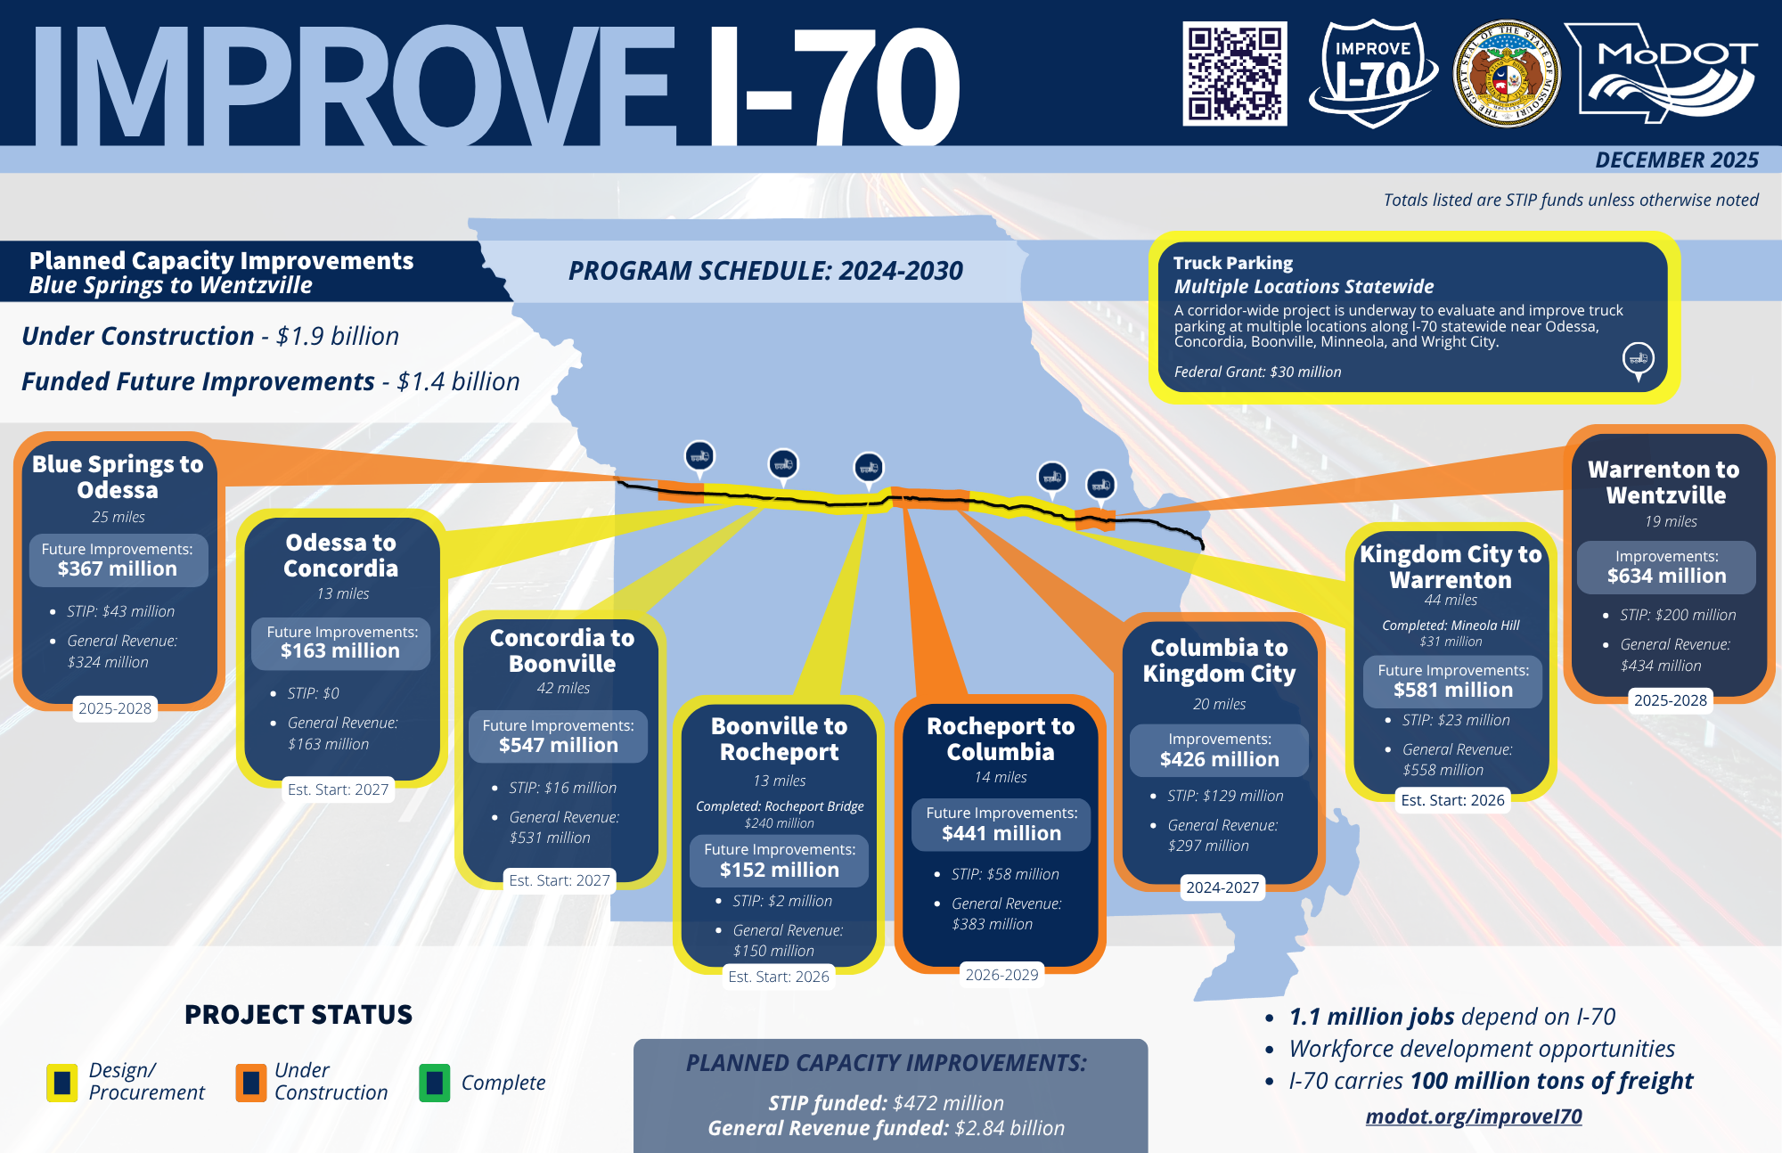

Slide 8
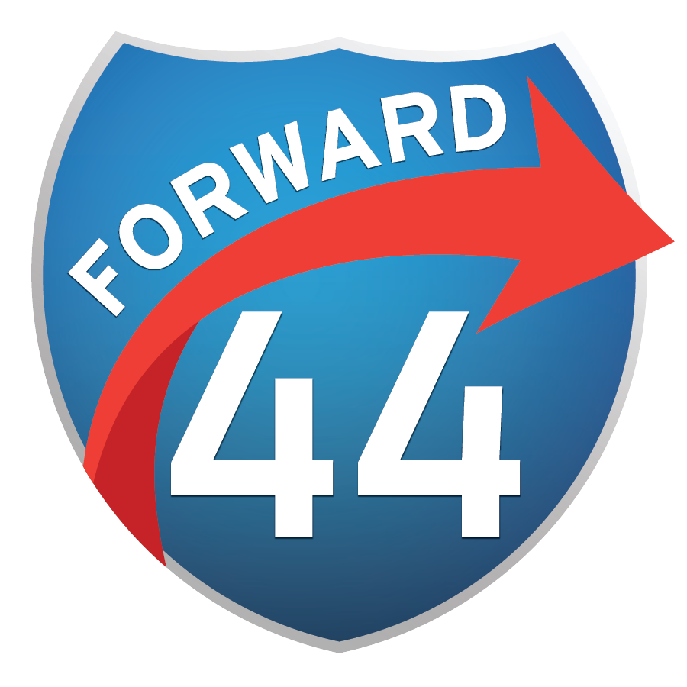
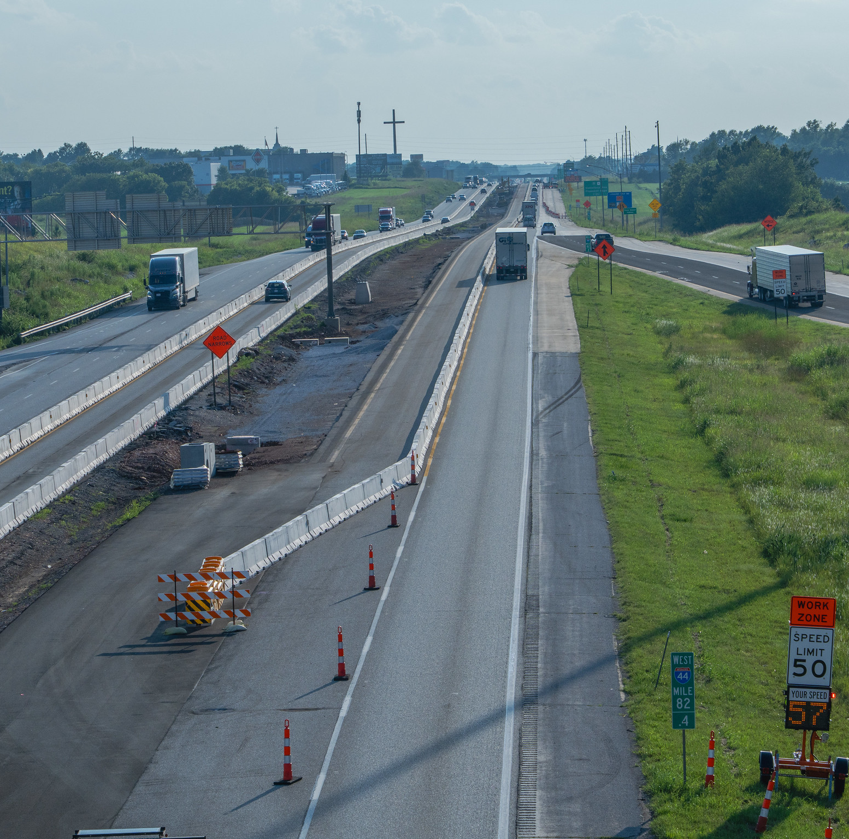
FORWARD 44
FY 2024: $20 million in General Revenue for I-44 environmental study
  Oklahoma state line to Route 100 (Franklin County)
  Update environmental studies completed in mid 2000s
  Study complete May 2025
FY 2025: $577.5 million in General Revenue for corridor improvements
  I-44 Springfield Route 160 to Strafford
  I-44 at I-49 Fidelity improvements

Slide 9
LEGISLATIVELY DESIGNATED & FUNDED INITIATIVES
$2.6 Billion in General Revenue:
Remaining I-70 - $1.8 billion
I-44 - $577.5 million
Rural Routes - $20 million
Multimodal projects - $7.1 million new in 2026
Off-system projects - $17 million new in 2026
Other projects - $132 million under development

Slide 10
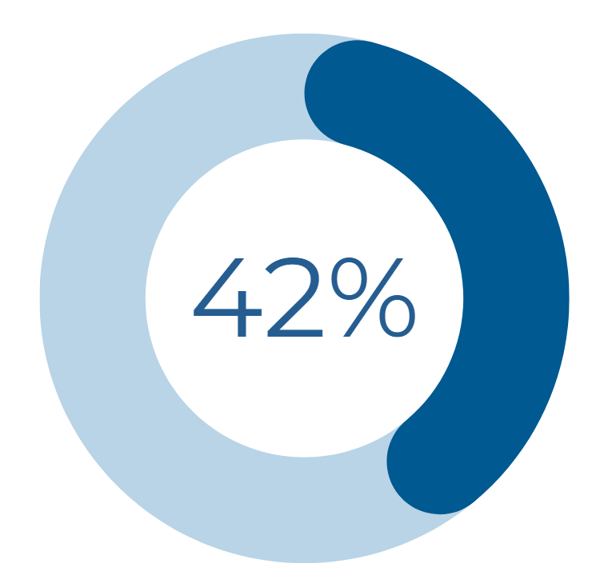
LEGISLATIVELY DESIGNATED & FUNDED INITIATIVES
$2 BILLION AWARDED FOR 330+ PROJECTS
SINCE 2020
42% OF PROJECTS AWARDED OR COMPLETED
AS OF OCTOBER 2025

Slide 11
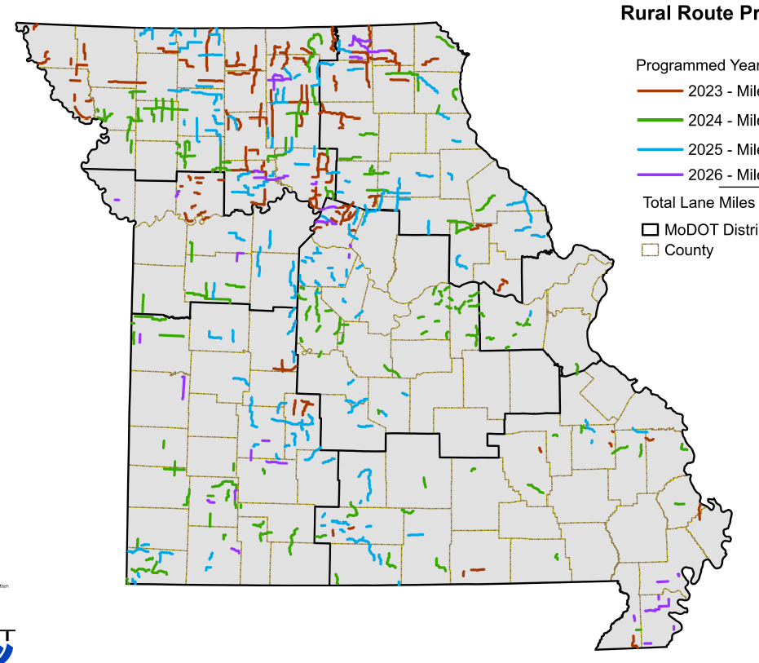
LEGISLATIVELY DESIGNATED & FUNDED INITIATIVES
  GOVERNOR’S RURAL ROUTES PROGRAM
Since 2023:
  $320 million of General Revenue
  60+ projects
  6,200+ lane miles improved

Slide 12
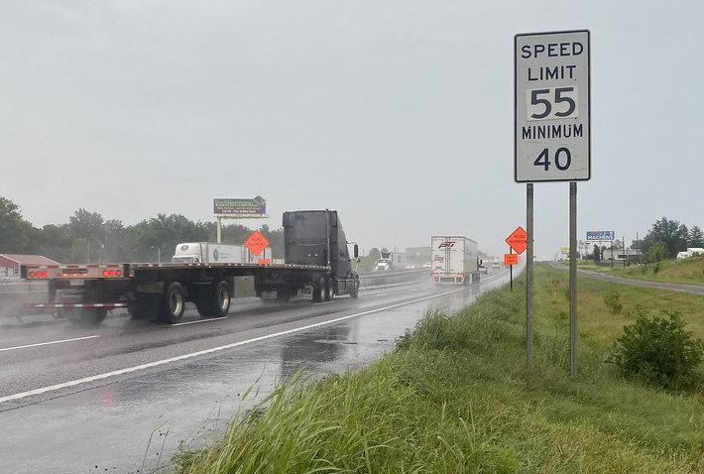
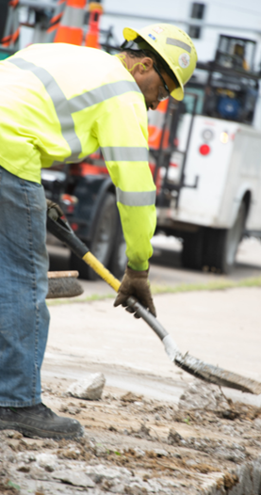
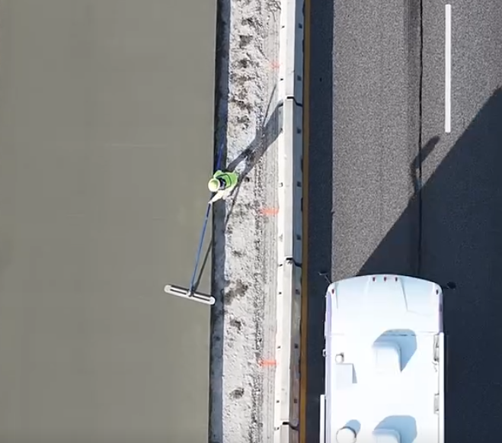
SAFETY FOCUS
2024: 23 work zone fatalities in Missouri
Improve safety of MoDOT, contractors, subcontractors, and traveling public​
  Improve work zone setups
  Educate drivers: BUPD​
  Work with MSHP

Slide 13
DIRECTOR’S ADVISORY GROUP
Collaboration with key stakeholders
  Elected officials, planning partners, contractors, economic development, workforce development, and users of all modes
Review and fine-tune, focused on continuous improvement
  Critical to project delivery and operations success

Slide 14
www.modot.org

