Slide 1

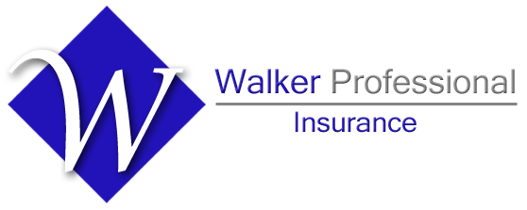
Combating Legal System Abuse:
Sovereign Immunity
Risk Management Advice from Walker Professional Insurance
Kristen Walker, CIC
Managing Partner

Slide 2

About Us
Doug Walker, CIC
Managing Partner / Agent
Holly Gill-Gaither, CIC
Sales Executive
Leeann Murray
Business Development
Kristen Walker, CIC
Managing Partner / Agent
Locally Owned since 1960
Specializations:
-Design Professionals
-Municipal: Cities & Towns
-Non-Profit Organizations
-CPA’s & Lawyers
Over 250 Design Firms
Licensed in ~35 states
Certified Insurance Counselors
Contract review
Continuing Education Facilitators
A/E ProNet Members

Slide 3
RISK MANAGEMENT NOTICE: The recommendations contained herein are intended as loss prevention measures for insurance purposes only. Walker Professional Insurance personnel are not providing a legal opinion on these contract provisions. The comments were not prepared by an attorney, are not legal advice, and cannot be relied upon as legal advice.
CONFIDENTIALITY NOTICE: This presentation is property of Walker Professional Insurance. Any disclosure, copying, distribution or the taking of any action in reliance of the contents of this presentation are not permissible without the permission of Walker Professional Insurance personnel.
​

Slide 4
Agenda
Explore Legal System abuse and what it means for the general public
Consider possible solutions to combat legal system abuse through Legislation
Overview of tort reform in various states

Slide 5
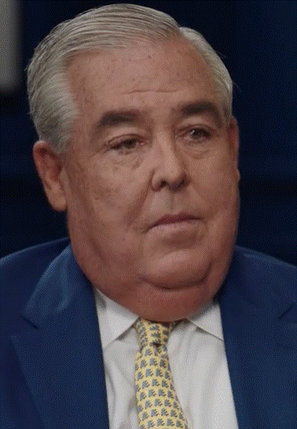
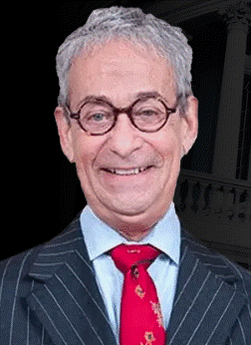
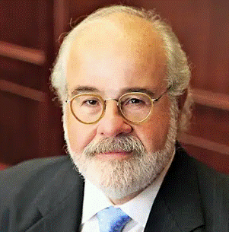
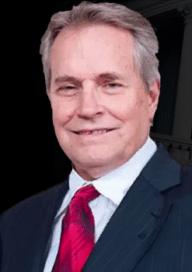



Meet the Plaintiff’s Bar
Terry Crouppen
John Morgan
Stuart Cofman
Larry Townsley
Notes:
How well do you know your plaintiff’s bar????
Cofman Townsley
Brown & Crouppen
Morgan and Morgan-click on link

Slide 6
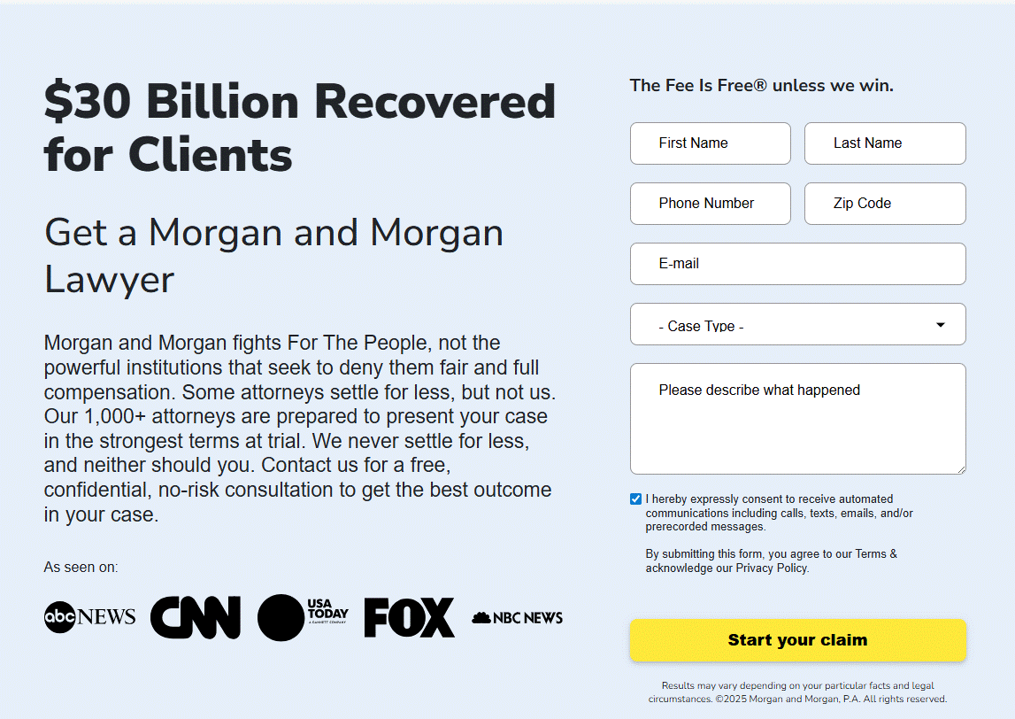
Notes:
Revenues

Slide 7
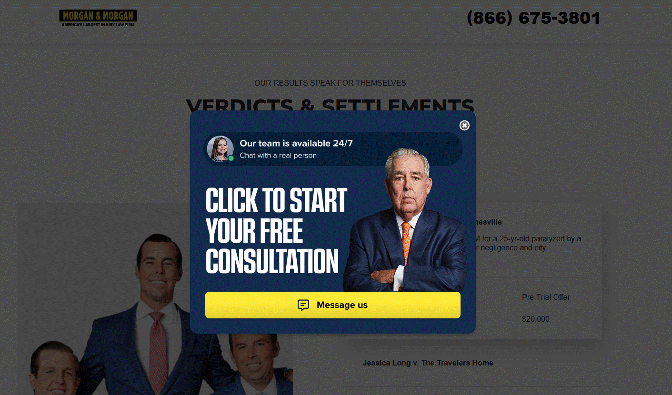
Notes:
Revenues

Slide 8
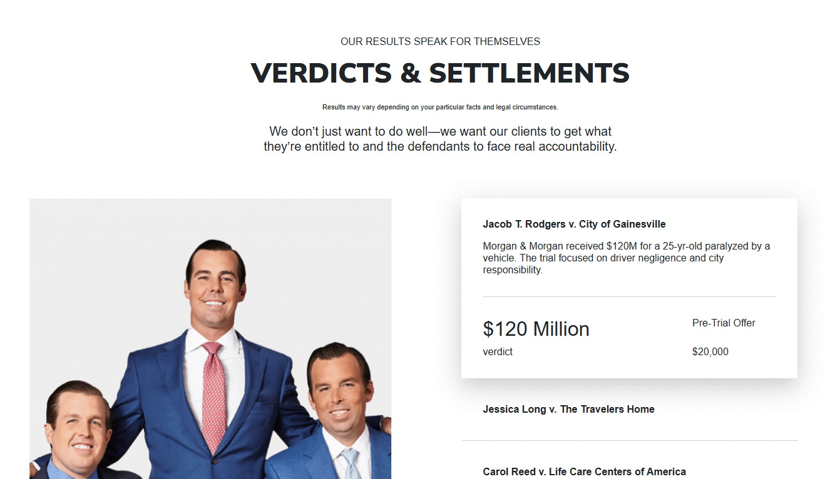
Notes:
Advertising budget: American Tort Reform association shows total spending on legal ads exceeding 2.4 billion in 2023 and over 2.5 billion in 2024 per Bloomberg law and insurance journal.
Morgan and Morgan reportedly spent 350Million on marketing including TV, radio, digital and billboards

Slide 9
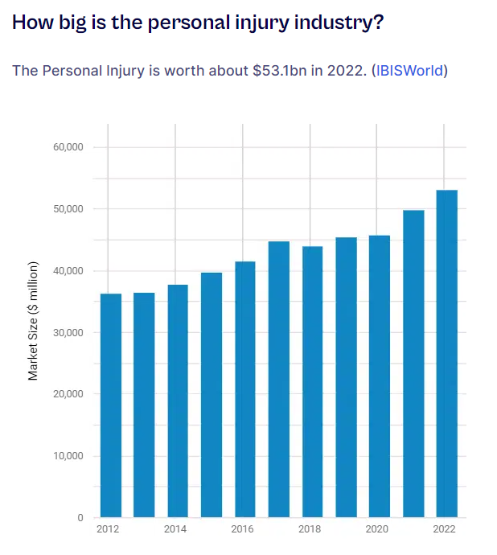
2023: $58.6bn (IBISWorld)
2025: $61.7bn estimated (IBISWorld)
Notes:
Revenues

Slide 10
States with the most personal injury cases:
  Florida, with 127.41 cases per capita
  Ohio, with 30.38 cases per capita
  New Jersey, with 30.34 cases per capita
  South Carolina, with 30.12 cases per capita
  Illinois, with 22.95 cases per capita
~Business Observer
Cities with the most personal injury cases:
  Albuquerque, New Mexico
  Memphis, Tennessee
  Detroit, Michigan
  Tucson, Arizona
  Kansas City, Missouri
~Forbes Advisor
Notes:
Car wrecks lead to more than half of all personal injuries in the U.S., according to the Law Offices of J.G.

Slide 11
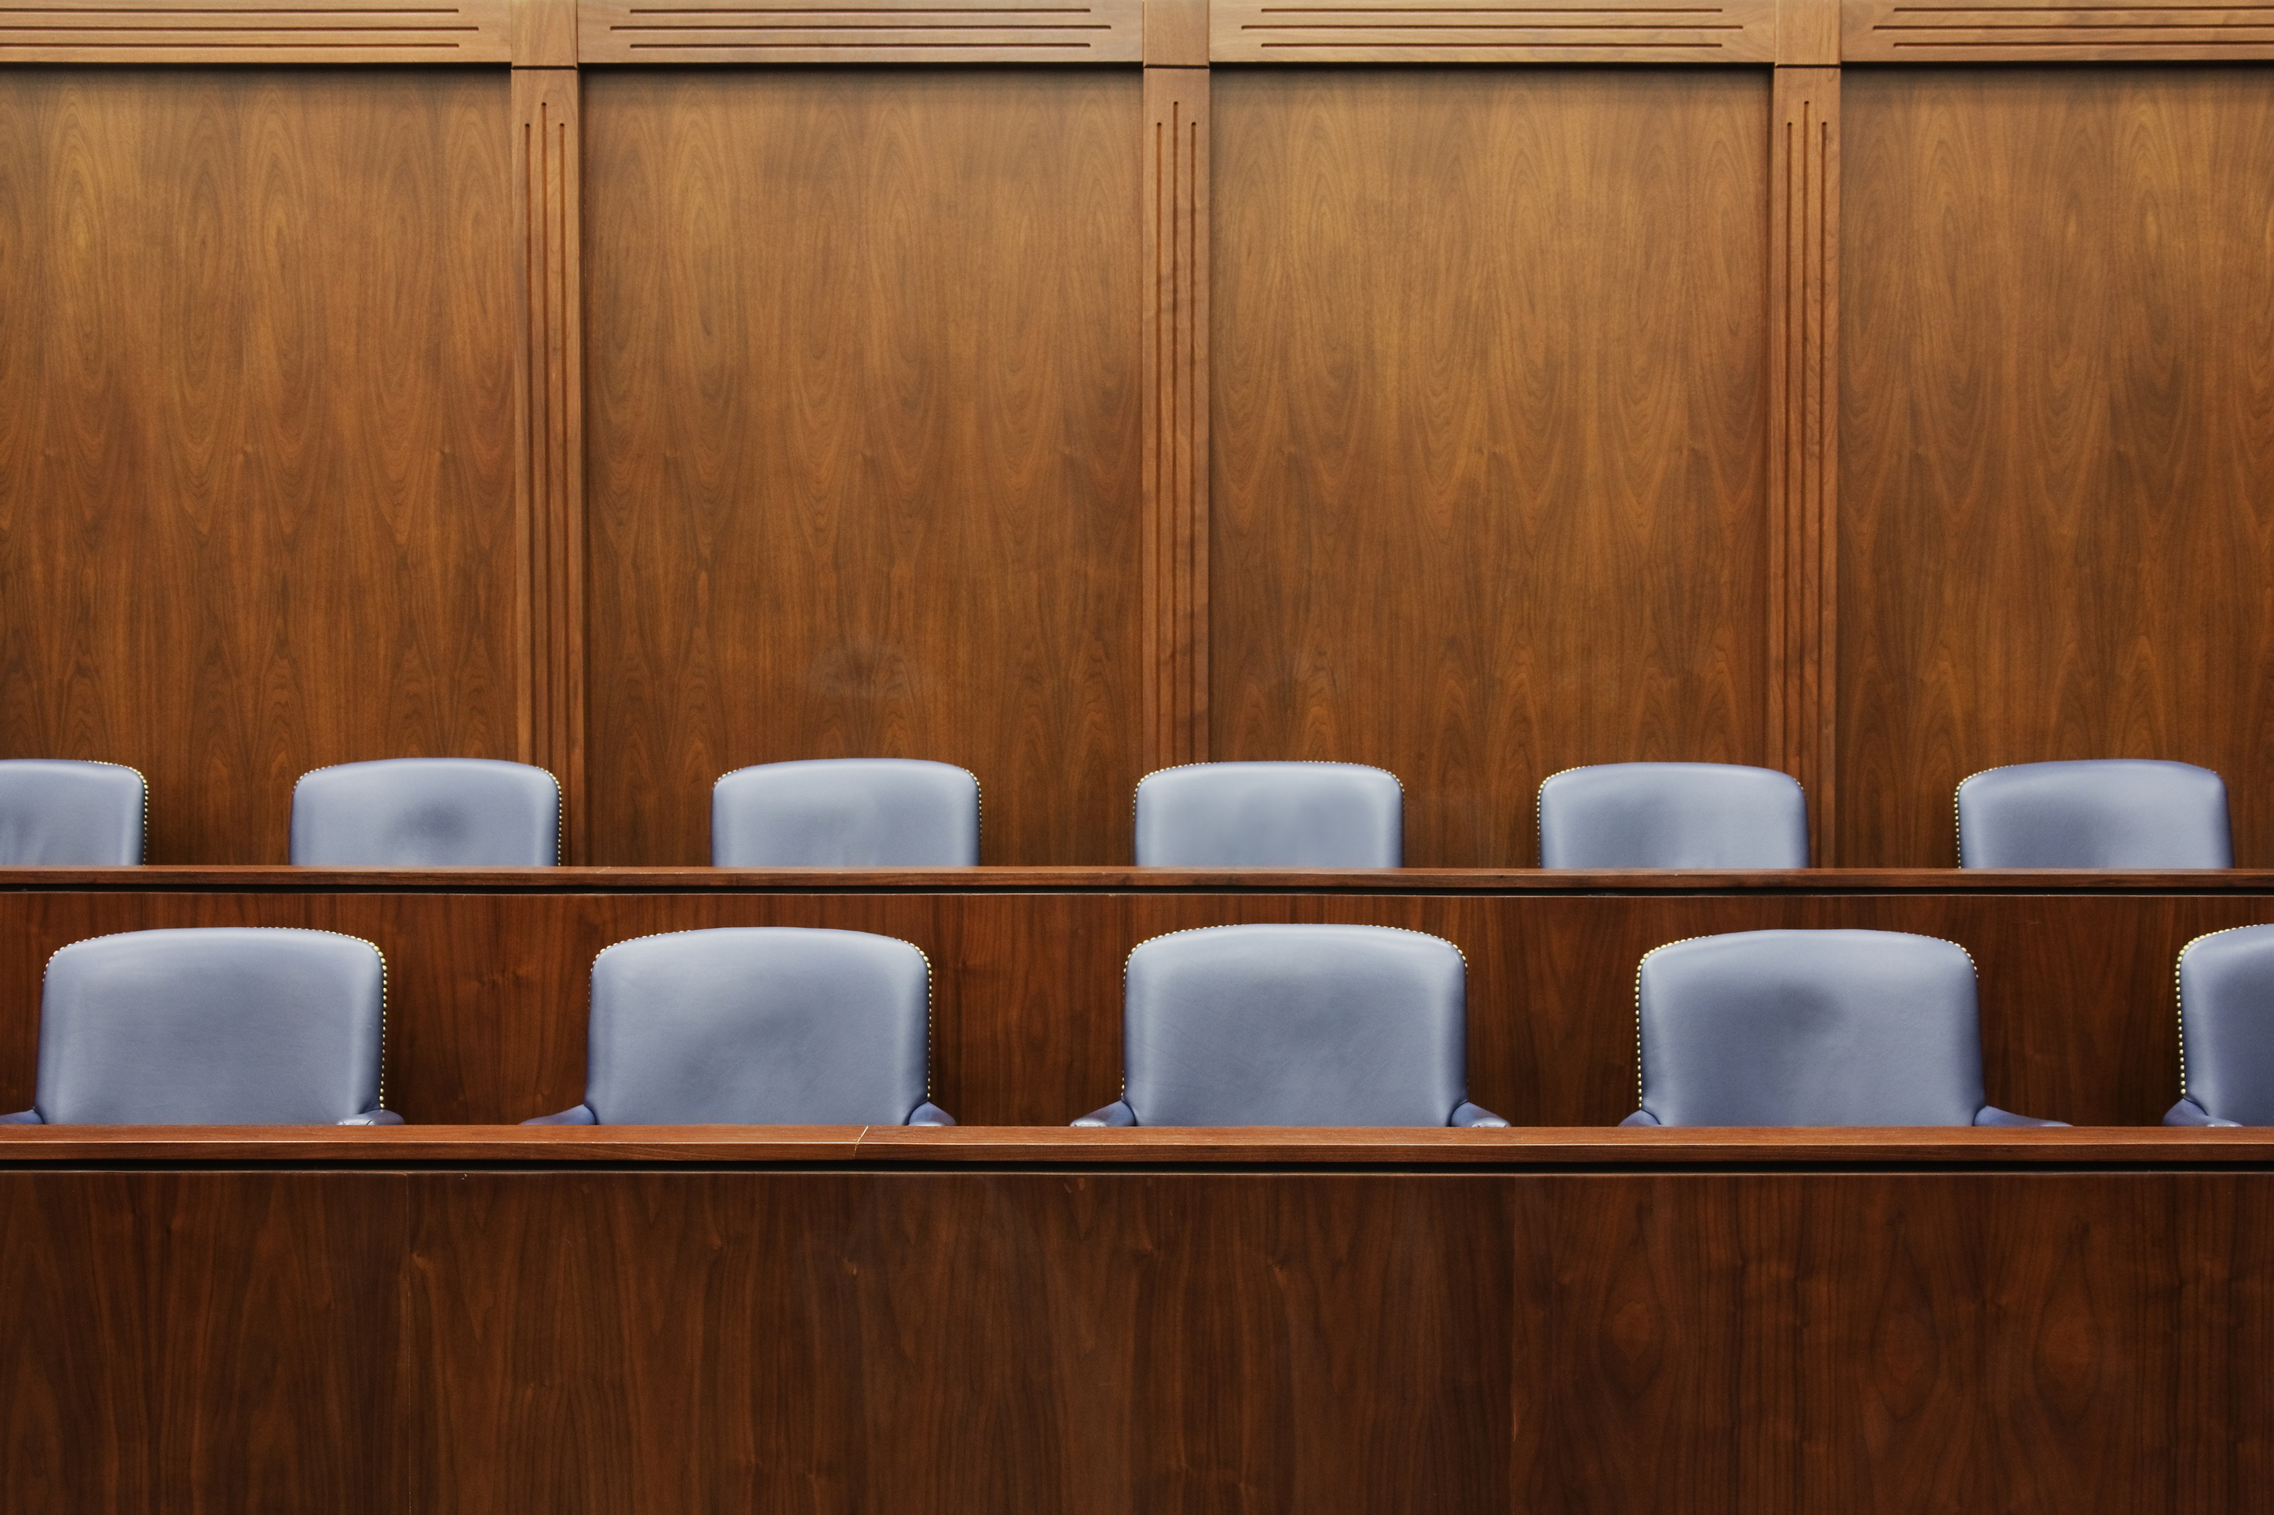
Jury’s Increased Scrutiny of Corporate Responsibility
Shift from that of a reasonable person (standard of care) to a community safety standard (safest means possible)
77% of jurors believe in “punishing” corporations through punitive damages.
~orrick- Groundbreaking Jury Research
Notes:
Best Lawyers: Increased scrutiny of corporate responsibility is reshaping personal injury litigation. Companies are being held accountable for failing to address safety risks, implement recalls, and maintain proper oversight in industries ranging from automotive manufacturing to workplace safety.
example,
You would agree with me that taking your hand off the wheel is not the safest way to drive?
Have you ever taken a sip of water on the road.
But you just told me that was not the safest way to drive. Why would you put the community and public in that sort of danger?
But all of us have taken a sip of water/coffee/coke or some other roadie while driving? All of us. It is not the safest but what a reasonable person would do while driving.
taking a sip of water on the road is not the safest course of action, but most reasonable people will drink from a water bottle if they get thirsty while driving.
If a truck driver causes an accident while drinking water, a lawyer using reptilian theory would highlight the fact that any kind of distracted driving is unsafe rather than try to convince the jury that the truck driver violated their duty of care toward others on the road.
Unreasonable to have 24/7 oversight of jobsite

Slide 12
How does this shift affect businesses?
Potentially changes how Jurors consider Standard of Care when rendering a verdict
Juries are more unpredictable
Jurors are desensitized to giving out Nuclear Verdicts (exceeding $10M)
Larger Settlements and more Global Settlements
Higher premiums and self-insured retentions (deductibles)
Insurance Carriers leaving the marketplace
Notes:
No longer what a reasonable person would do but rather what could they have done to be safer
Throw the rules out the window
If you do not send a message with your verdict, similar harm will happen to you or those in the community. (Social Inflation)
Parties don’t want to risk going to trial. They also don’t want to be left out while other parties have settled out.
More claims dollars result in higher premiums, more claims frequency so higher self insured retentions or deductibles.
Not enough premium to cover the risk. EX: Liberty Mutual; Less project policy carriers now as well.

Slide 13
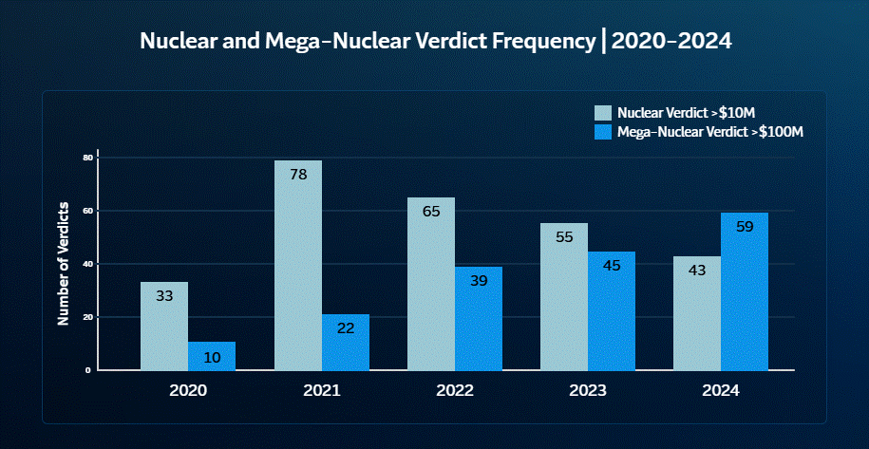
~Travelers
Notes:
Travelers did a study of the top ~100 verdicts
Nuclear Verdict greater than 10M
Nuclear Verdict greater than 100M
Recent Top 100 Verdicts data shows that mega-nuclear verdict awards (over $100 million) are growing at a faster rate than nuclear (over $10 million). In fact, 2024 marked the first year this decade that mega-nuclear verdict awards outpaced nuclear.

Slide 14
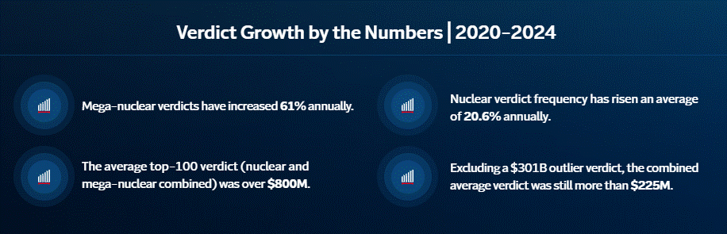
~Travelers

Slide 15
Calling for Legal System Reform
Hanover (2024) “Legal system abuse is the signature advocacy priority for American Property Casualty Insurance Association (APCIA) in 2024 and will remain top priority in 2025, focusing on restoring certainty to an unstable legal system environment and building coalitions to rein in the growing tort tax on individuals, families, and businesses.”
Notes:
Insurance Companies are starting to put out public statements of their advocacy for legal system reform to combat legal system abuse and putting forth efforts to educate the public.
Hanover 2024: Legal system abuse reform is the signature advocacy priority for (American Property Casualty Insurance Association) APCIA in 2024 and will remain top priority in 2025, focusing on restoring certainty to an unstable legal environment and building coalitions to rein in the growing tort tax on individuals, families, and businesses.
The goal is to reduce legal system abuse costs and uncertainty, achieve favorable liability, bad faith, litigation financing and damages reforms, and defend against adverse proposals such as statute of limitation (SOL) revivers and increased legal system abuse by non-lawyers.

Slide 16
Definition: Legal System Abuse
Another word for Social Inflation: dramatic increases in insurance claim costs resulting from increased litigation, broader definitions of liability, more plaintiff friendly legal decisions, and larger jury awards.
Policyholder or plaintiff attorney practices that increase costs and time to settle insurance claims.
While litigation is generally considered a policyholder’s last resort, legal system abuse can occur when a disputed claim could have been resolved without judicial intervention

Slide 17
Legal System Abuse: What does it cost?
US Chamber of Commerce Institute for Legal Reform estimates the aggregate tort costs in the US amounted to $529 billion in 2022 which equates to approximately $4,207 per American household. $229 Billion of that is attributed to General and Professional Liability (not including auto).
Tort costs have grown at an annual rate of 6% per year over the period 2016 to 2020—with commercial liability growing at a faster rate than personal liability. This exceeds both the growth in inflation, which averaged 1.9%, and GDP, which grew at 2.8% over the same time period.
In Missouri, tort costs make up 2.1% of the State’s GDP and costs Missouri households $3,387.
~U.S. Chamber of Commerce Institute for Legal Reform : Hidden Costs of Lawsuits on U.S. Households Continue to Grow | U.S. Chamber of Commerce
Notes:
The costs of the legal system and the efficiency with which it delivers compensation to injured parties have not been routinely measured.
The US Chamber of Commerce Institute for Legal Reform seeks to address the cost of the American Legal system.
This study seeks to address that issue by providing an estimate of the costs and compensation paid in the U.S. tort system (hereafter referred to as “tort costs”) using insurance data and estimated self-insured costs.
The costs included in this study are only those that are insurable, which will understate tort costs to the extent that they are uninsurable.
The average growth rate of tort costs in Missouri from 2016 through 2022 = 6.5%
Hidden Costs of Lawsuits on U.S. Households Continue to Grow | U.S. Chamber of Commerce
Bullet #2 is at 7.1% now and 8.7% for business only cases.

Slide 18
Definition: Third Party Litigation Funding (TPLF)
Third party funding from sources such as private equity, hedge funds, university endowment funds, certain trusts and other deep-pocketed investors that can afford to take on high risks.
Invest in pending litigation in exchange for a percentage of the payout
Disbursements are used for legal expenses including expert witness and attorney fees
There is no recovery if the case is lost or remains unsettled.
Notes:
If the recipient wins or settles their lawsuit, the funder receives the dispersed amount plus interest.
When funding is involved in commercial litigation, the legal firms typically get paid no matter how the case is resolved, even while their client or TPLF may not see a penny.
The disbursement is referred to as a nonrecourse loan because recipients do not have to pay back the money if the case is dismissed or lost.
When TPLF is involved in a claim/litigation, plaintiff’s compensation goes from around 55% of the total cost to 43%.

Slide 19
Third Party Litigation Funding (TPLF)-cont…
According to Swiss Re, more than half of the $17 Billion invested into TPLF globally in 2020 was deployed in the US and estimates this will increase to as high as $30 Billion by 2028.
Recent annual returns surpassing 20%, with some reported as high as 52%
Foreign adversaries are investing in US litigation to gain access to sensitive information and/or evade sanctions
Notes:
Chinese TPLF firm financed multiple intellectual property lawsuits against Samsung in US courts and Russian Billionaires with ties to Vladimir Putin have funded litigation in the US and UK to evade sanctions.
Since the S&P has averaged about 10% since its inception, this does not appear to be going away any time soon but rather growing.

Slide 20
Why should insurers and policyholders be concerned about TPLF?
TPLF has the potential to draw out litigation and costs.
TPLF increases the threat of moral hazard
David vs Goliath is no longer the primary dynamic in TPLF
The overall lack of transparency in TPLF arrangements impedes fair play causing difficulties
for opposing parties to manage legal risks and associated costs;
quantifying the impact on funded verdicts and social inflation
~Insurance Information Institute; iii
Notes:
When each side of the lawsuit has a sense of what it might take to resolve the situation, the attorneys can more easily find a way to do it as quickly and as cost effectively as possible which is why information about insurance coverage is often known on both sides of the table.
However, attorneys and their clients typically refuse to share whether an outside investor has a financial interest in the lawsuit’s outcome unless they are compelled by the court.
TPLF essentially erodes the incentive to litigate as efficiently as possible.
To get paid regardless of the outcome, law firms cap their rates and forgo a portion of any potential settlement.
It can sometimes be more profitable for firms to keep litigating, occasionally employing more novel and expensive tactics.
It is logical to suspect that sharing a piece of the settlement pie with another party can incentivize wanting a bigger pie, perhaps even beyond hat would’ve otherwise been necessary to feel justice has been served.
TPLF proponents argue litigation financing helps underfunded plaintiffs pursue justice.
Advocacy organizations such as NAACP and ACLU have been financing lawsuits for decades as third parties to help push those lawsuits in matters that its organization supports.
With TPLF, the sole purpose of the funders is financial gain/profit. Less about supporting the right to seek justice

Slide 21
The Financial Impact of TPLF
Larger claim payouts with smaller percentages going to the claimant when attorneys are involved.
Increase in social inflation (inflated claims, litigation costs and unpredictability)
Higher Premiums; Higher retentions; Lower Limit offerings

Slide 22
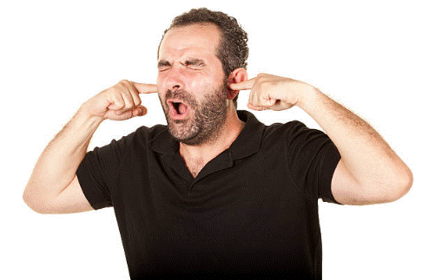
Solutions…
Insurance/Risk Management
Contractual
Legislative
Notes:
Insurance/Risk Management Options-stop doing road projects, buy project or “wrap up policies” which have several pros and cons. Either way are pricy and does not solve the nuclear verdicts or frivolous lawsuits.
So we will focus on Legislative efforts and what your state and other states are doing.

Slide 23
Legislative Solutions:
Contractor/Construction Engineering Inspector (CEI) is an agent of the Municipality: Sovereign Immunity
  Contractor/CEI is an extension of the government entity (owner) (staff augmentation)
  Immunities protecting municipalities would extend to the Contractor/CEI
  Municipal Monetary caps would extend as well
  Can work in states without an immunity Statute like PA Burrows
  CONSIDERATIONS:
    Claim may still need reported
    May still have legal costs (motion to dismiss vs summary judgement)
    Municipal Monetary caps can still be a lot
Notes:
Met with Travelers Claims Professional and they have seen success when the AE firm is hired as an agent of the municipality to get out on summary judgement in conjunction with that municipality. Specifically in the burrows.
Cost for Motion to Dismiss: 5-10K
Cost of Summary Judgement: min 30-35K +
In essence, a motion to dismiss says, "Even if the plaintiff's story is true, they haven't stated a valid legal claim."
A motion for summary judgment says, "The facts are undisputed, and based on those facts, I should win."
Motion to Dismiss before discovery. Evidence NOT considered
Summary Judgement after most often filed after discovery. Evidence Reviewed.

Slide 24
Legislative Solutions: Sovereign Immunity
  Monetary/Municipal Caps
State | Monetary Limits
Alabama | None
Texas | 250K per person / 500K per occurrence
Florida | 200K per person / 300K per occurrence
Missouri | 517,306 per person / 3,448,710 per occurrence
Indiana | 700K per person / 5M per occurrence
Notes:
MO: 2025 $3,448,710 $517,306
Neither the state nor its agencies or subdivisions shall be liable to pay a claim or a judgment by any one person which exceeds “X” amount or per accident/occurrence
Interesting in Florida and Texas, the question regarding LOL 250K or less, FL and TX they report projects associated with the municipality as an LOL as that would be their max liability if judgement is granted.

Slide 25
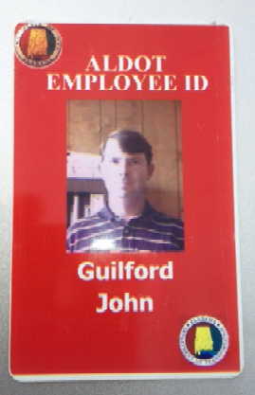
Legislative Solutions: Sovereign Immunity-Alabama Case
  Motion to Dismiss filed by Thompson Engineering:
  Estate of Gresham vs William Barrow (plus several other defendants including Thompson Engineering)
  Wrongful death case: William Barrow driving wrong direction on highway resulting in head on collision with Gresham
  Motion’s argument is centered on ALDOT’s workload exceeding its resources thus outsourcing to consultants to provide CEI services; thus providing the same work, same manner as direct employees of ALDOT
  Argument: Thompson Engineering was acting as an agency of the state…and since ALDOT is a state agency…, and therefore is absolutely immune from suit, the claims against Thompson Engineering are due to be dismissed.
GRANTED!!
Notes:
several Thompson Engineering personnel are former ALDOT employees.
This project was designed by ALDOT and Thompson Engineering’s general role with respect to the project is to observe the contractor’s work to make sure that it complies with ALDOT’s requirements.
He (PM) considers himself to be the “eyes and ears” of ALDOT for the project.
Guilford (PM) submits reports to ALDOT using the ALDOT computer system and enters data in the “Alabama Department of Transportation Diary Summary Report for Contract” using his ALDOT password.
He also communicates with others involved in the project using his ALDOT email address
In addition, ALDOT has issued picture ID badges to Thompson Engineering employees who perform CE&I work and who frequent the ALDOT building
Article I, § 14, Alabama Constitution of 1901, provides that the State of Alabama is immune from suit.1 Here, the evidence demonstrates that Thompson Engineering is also immune from suit. The road construction project at issue was designed by ALDOT, and Thompson Engineering’s general role with respect to the project was to observe the contractor’s work to make sure that it complied with ALDOT’s requirements. In other words, Thompson Engineering
performed the CE&I services traditionally and historically performed by ALDOT on roadway projects in the State.
Thompson Engineering was acting as an agency of the State with respect to the construction project referenced in the Complaint. Since Thompson Engineering essentially “stood in the shoes” of ALDOT for this project, and since “ALDOT is a State agency … and, therefore is absolutely immune from suit,” the claims against Thompson Engineering are due to be dismissed.
LESSON LEARNED: Thererefore, there may be some opportunities on how you structure your relationship and contracts with MODOT or your municipalities

Slide 26
Legislative Solutions: Sovereign Immunity-Alabama Case
  Motion for Summary Judgement filed by Volkert Inc:
  Various residential plaintiffs vs Volkert Inc (and several other defendants from design and construction team)
  Plaintiffs allege that they were harmed as a result of the defendants’ engineering, demolition and other construction activities during interstate/interchange and bridge project including depositing of massive and continuous amounts of dust and dirt on their property and in their homes.
  Motion for Summary Judgement Includes:
    Volkert is entitled to state-agent immunity for its design work on the project
    No expert testimony to establish a breach of the standard of care
    Since Volkert did no construction, it did not create dust

Slide 27
Legislative Solutions: Sovereign Immunity-Alabama Case
  Motion for Summary Judgement filed by Volkert Inc-CONT…:
  Decision:
    Alabama statutory immunity provides for construction monitoring services and Volkert provided design services, Therefore, no immunity is granted for design services
    Further Volkert is clearly a private domestic corporation and therefore, is NOT an “agent of the state” for design services.
    THEREFORE, partial granting for immunity from CEI services but NOT design services.

Slide 28
Legislative Solutions: Sovereign Immunity
  Which services and/or projects are included:
State | Services Included | Projects
Alabama | Construction Monitoring (Construction Engineering inspection) | Highway, Road, Street, overpasses, bridges, utilities, ROW, airports, runways, taxiways, water ports, waterways, bays, rivers, streams, railways and all other assets or convenyances of convenience, safety or transportation.
Texas | Inspection and Monitoring includes contractors if in compliance with contract documents | Highway, Road or Street only
Florida | Inspection and Monitoring | State road, bridge or other transportation facility.

Slide 29
Legislative Solutions: Sovereign Immunity
  Which contracted Entities are included:
State | Contracted Entities
Alabama | State, P3, County, City, Town, all other Municipal
Texas | TDOT
Florida | FDOT or other project if in contract with FDOT
Notes:
Another consideration: Florida included subconsultants to the professional firm contracted with FDOT if providing CEI services.

Slide 30
Third Party Litigation Funding: Education and Transparency
Education: Insurance companies educating and advocating, US Chamber of Commerce Institute for Legal Reform, Insurance Information Institute, white papers, webinars, etc
Transparency: Indiana, Louisiana, Montana, West Virginia, and Wisconsin. 2025 TPLF wins in Colorado, Arizona and a Big win in Georgia.
Notes:
Insurance companies and other advocating companies are taking a position on legal system abuse and educating through white papers and webinars and advocating for reform.
US Chamber of Commerce Institute for Legal Reform is providing data, and studies and opinions.
The Insurance Information institute is using this information to report back to consumers and insurance companies who are in turn advocating for transparency.
Recent legislation in Indiana, Louisiana, Montana, West Virginia and Wisconsin address secretive Third Party Funding.
Indiana enacted HB 1160 in 2024 that mandates the disclosure of funding, prohibits funders from accessing proprietary data and bans them from influencing or controlling law suits.
They have not yet been able to disclose who the third party funders are but a step in the right direction.
This new legislation will help ban funders from influencing or controlling lawsuits like in the Sysco vs Burford case where Burford, arguably the largest litigation funder in the world, vetoed their client’s settlement decision.
2025 Georgia Governor signs transparency bill banning 4N funders from engaging in US litigation, probibits litigation financors from controlling litigation, preventing funders from recovering more than the plaintiff, etc.

Slide 31
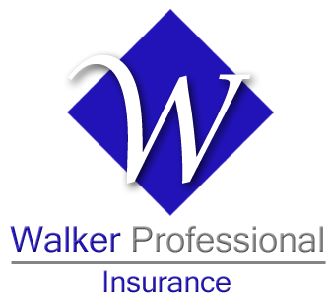
Questions? Comments?

Slide 32
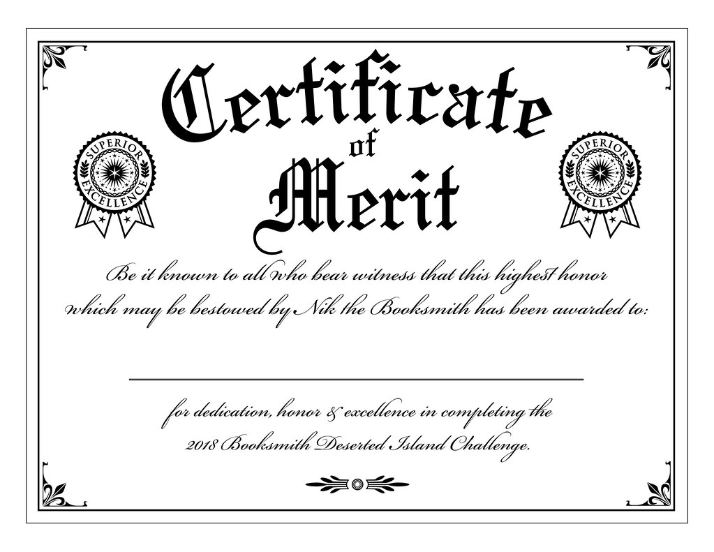
Legislative Solutions:
Certificate of Merit cont.:
  States with Certificate of Merit Requirements?
Arizona | Nevada
California | New Jersey
Colorado | Oregon
Georgia | Pennsylvania
Maryland | South Carolina
Minnesota | Texas
~O’Hagan Meyer
Notes:
The American Institute of Architects, the American Consulting Engineers Council, the American Society of Civil Engineers, and the National Society of Professional Engineers have been involved in promoting tort reform legislation at both the national and state levels to enact certificate of merit statutes.
California was amongst the first to require a certificate of merit for design professionals in 1979.
Several states already have this for licensed medical professionals.

Slide 33
Legislative Solutions:
Certificate of Merit cont.:
  Other Screening Mechanisms?
      Hawaii and Kansas have enacted legislation requiring plaintiffs to file their professional negligence claims with a review or screening panel before filing suit against architects and engineers.
      Mandatory notice to cure alleged defects.
~O’Hagan Meyer

