Slide 1

Building Culture & Leading in Today’s Workforce
Why & How To Engage…
Inspire and Leave a Legacy…

Slide 2


State of the Industry
Workforce vs. Work
  Key State Construction Initiatives
    $14.6B STIP (2025-2029)
    $1.94B Bridge/Pavement Maintenance
  42-47 yrs old +/-
    22.5% - 55 yrs old
    10% under 25 yrs old
Unknowns
  Volatile Economy
  Supply Chain
Notes:
U.S. gross domestic product (GDP)—the value of all goods and services produced in the country—totaled $30 trillion at a seasonally adjusted annual rate in the 1st quarter of 2025; construction contributed $1.3 trillion (4.5%).
In Missouri, construction contributed $22 billion (4.8%) of the state’s GDP of $463 billion.

Slide 3
Industry Challenges:
    Skill Shortages & Knowledge Gaps
    Safety & Health Concerns
    Project Delays & Productivity
    Recruitment & Retention
    Succession Planning?

Slide 4
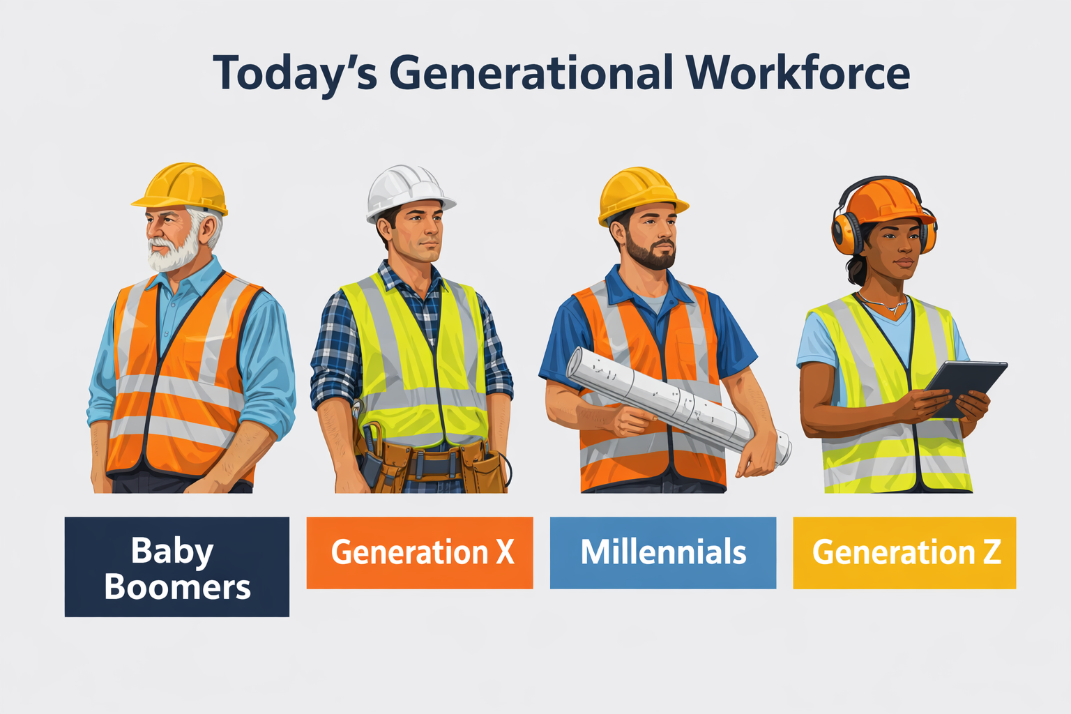
Workforce Challenges
  Misalignment of goals / effort
  Lost opportunities and productivity
  Poor communication
  Greater change resistance
  Poor teamwork
  Lower staff engagement
  Greater staff turnover
  Unnecessary conflict

Slide 5
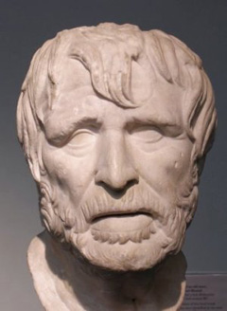
“I see no hope for the future of our people if they are dependent on the frivolous youth of today, for certainly all youth are reckless beyond words. When I was a boy, we were taught to be discrete and respectful of elders, but the present youth are exceedingly wise and impatient of restraint.”
Hesiod 700 B.C.

Slide 6

Notes:
Engage our workforce !
Mentor our workforce !
Retain our workforce1

Slide 7
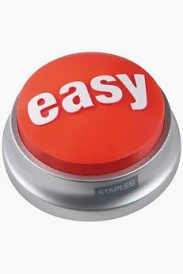

Slide 8
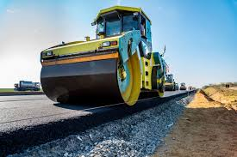
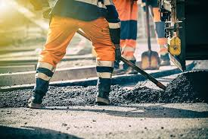
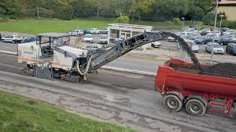
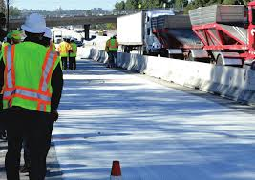

Slide 9



Think outside the box!
YOU ARE NOT ALONE
Notes:
2024 Cancer Deaths estimated to be 660,000 in America
The provisional estimates released today indicate that suicide deaths further increased in 2022, rising from 48,183 deaths in 2021 to an estimated 49,449 deaths in 2022, an increase of approximately 2.6%. However, two groups did see a decline in numbers, American Indian and Alaska Native people (down 6.1%) and people 10-24 years old (down 8.4%).
Recent data shows suicide among older people has risen precipitously. The U.S. suicide rates reached an 80-year high in 2022 of nearly 50,000 people, according to provisional data from the National Center for Health Statistics (NCHS).
The rate of 14.3 suicides per 100,000 people is the highest it has been since 1941. There have been periodic spikes in U.S. suicide rate dating back more than a century, with peaks during World War I, the Great Depression and the Great Recession.
Between 2000 and 2022, rates increased approximately 36% (Centers for Disease Control and Prevention)

Slide 10


Slide 11

Work
Authority
Work
Responsibility

Slide 12
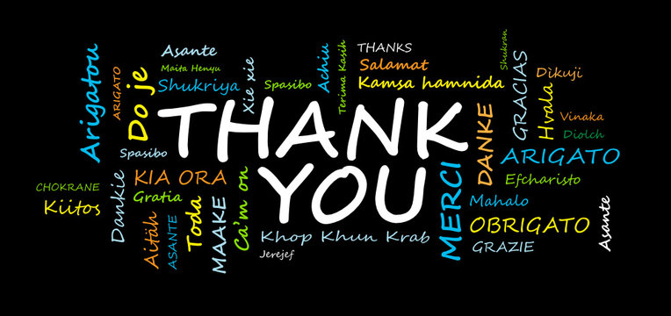

Slide 13
Leadership vs. Management
Management involves processes of planning and control
Leadership is a distinct process of people working together to achieve something, driven by influence and connection rather than solely by rank or authority.

Slide 14
Leadership is the act of influencing and inspiring a group to work toward a shared goal by providing guidance, fostering collaboration, and unlocking the collective potential of individuals. It is not limited to formal authority but rather emerges through actions, trust, and empathy, involving the ability to adapt to change, make sound decisions, and cultivate growth and well-being within the team.
Merriam-Webster defines “Leadership” as: “the office or position of a leader, the capacity to lead, or the act or an instance of leading.” dictionary defines leadership

Slide 15

Respect
Communicate
Listen
TRUST

Slide 16
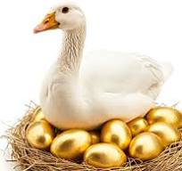

Slide 17

IT’S OK TO BE…
HUMAN…
Each of you hold the Key…
LEGACY…

Slide 18
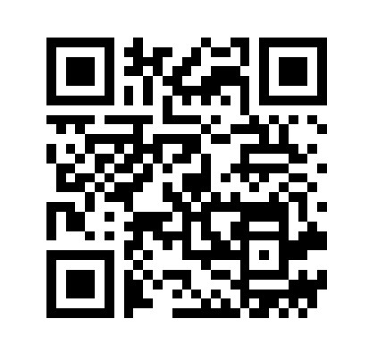
Brandon Anderson
Vice President of Safety
(636) 887-5207
Email: banderson@agcmo.org
Notes:
U.S. gross domestic product (GDP)—the value of all goods and services produced in the country—totaled $30 trillion at a seasonally adjusted annual rate in the 1st quarter of 2025; construction contributed $1.3 trillion (4.5%).
In Missouri, construction contributed $22 billion (4.8%) of the state’s GDP of $463 billion.

