Slide 1



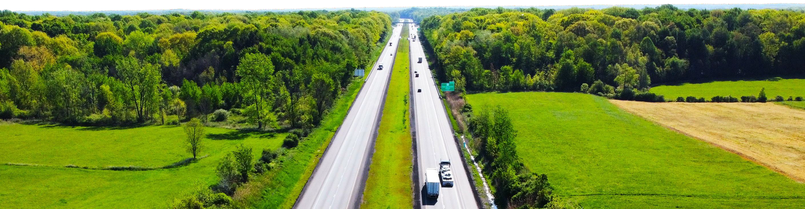

THE ROAD AHEAD:
NAPA’S NATIONAL ADVOCACY
M i s s o u r i A s p h a l t P a v e m e n t A s s o c i a t i o n | J a n u a r y 6 , 2 0 2 6
Nile Elam
Vice President of Government Affairs, NAPA
2024 Sheldon G. Hayes Award Winner Lindy Paving Inc., New Galilee, PA

Slide 2

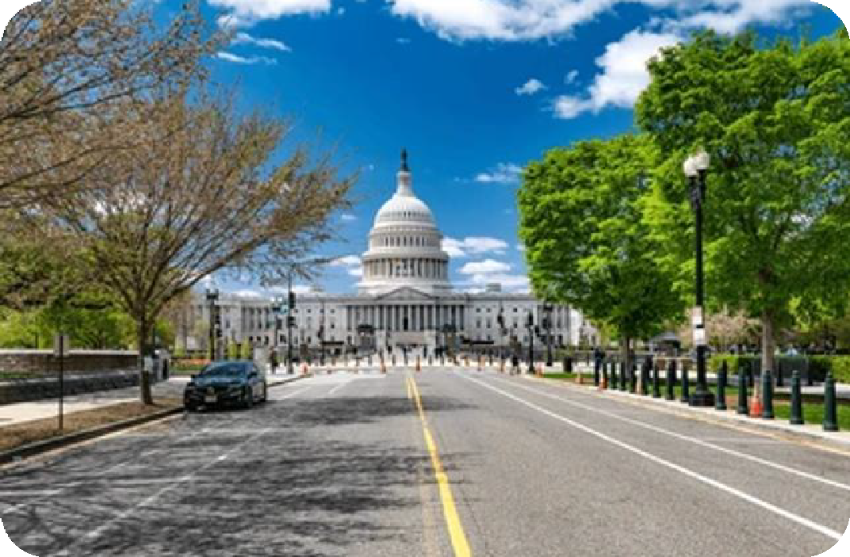

Agenda
Introduction and NAPA overview
OBB passage & Permit reform
T&I Stakeholder Portal submission
  NAPA’s legislative priorities and highway
bill timing
  WZS, BABA, formula funding & more…
Work zone safety push and coalition
NAPA’s T&I testimony on the HTF and
highway funding
Asphalt market locally and nationally
Asphalt production impact from tariffs
NAPA meeting with DOT Secretary Duffy
EH&S / Regulatory Update
Get involved!
Q/A
© 2024 National Asphalt Pavement Association. All Rights Reserved
2

Slide 3





OUR MISSION:
To advance the asphalt pavement industry through leadership, stewardship, and member engagement.
OUR VISION:
Sustainable transportation infrastructure that paves the way for thriving communities and commerce.
© 2025 National Asphalt Pavement Association. All Rights Reserved
3

Slide 4





MISSOURI MEMBERS
Gold Club (50+ Years)
30-Plus Club
Members
APAC-Missouri, A CRH Co.
CWM Equipment
Maxam Equipment
New Frontier Materials
Simpson Construction Materials
Amrize
Apex Paving Co.
Asphalt Pro Magazine
Capital Materials
Christensen Brothers Asphalt
Delta Asphalt
Heartland Asphalt Materials
Ideker
Jackson Engineering Solutions
Kirby-Smith Machinery St Louis Branch
Leo Journagan Construction Co.
MLC (Mississippi Lime Company)
N.B. West Contracting Co.
Pace Construction Co.
Seal-O-Matic Paving Co.
Superior Bowen Asphalt Co.
Tarmac International
Verde Resources
W. L. Miller
XBE
State Advisor
Brian Johanning, Superior Bowen Co.
© 2025 National Asphalt Pavement Association. All Rights Reserved

Slide 5
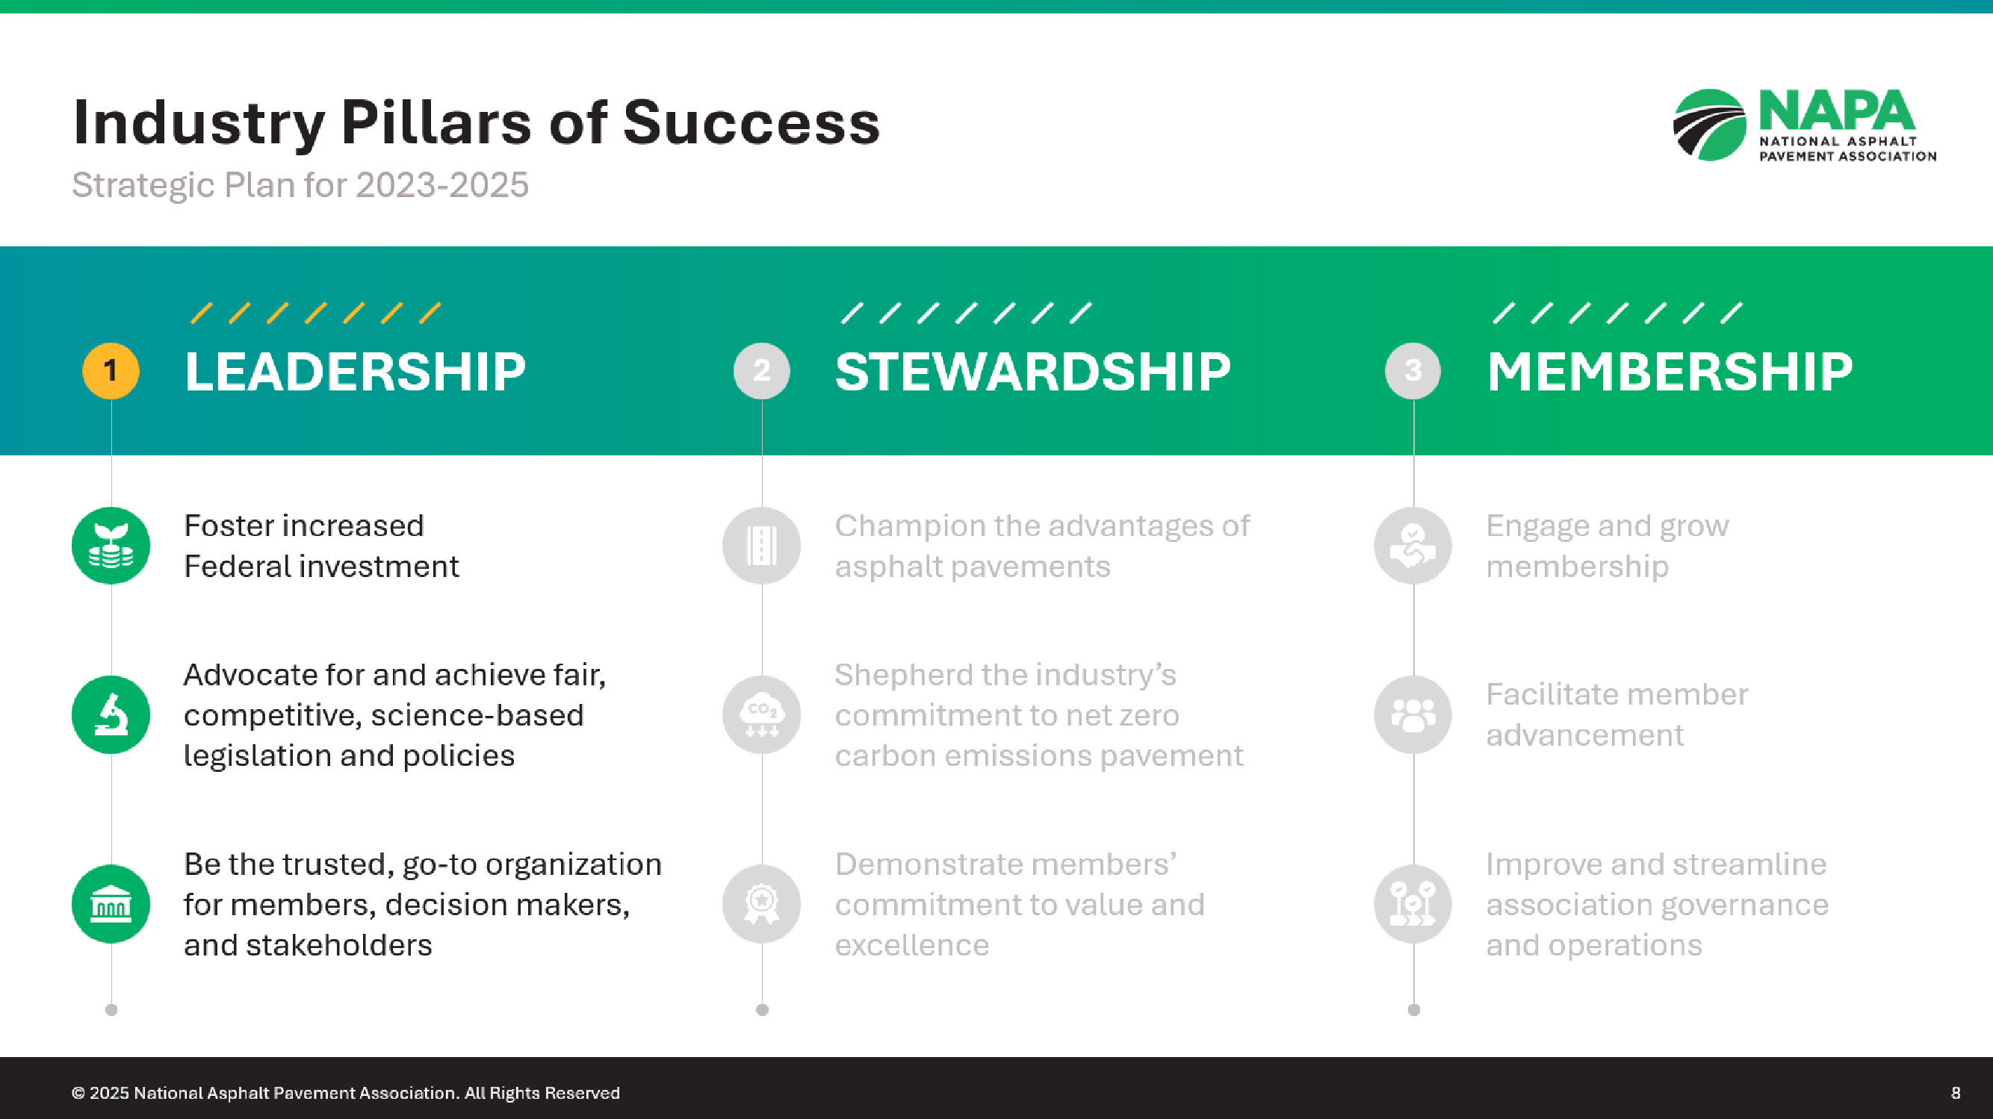
© 2025 National Asphalt Pavement Association. All Rights Reserved

Slide 6
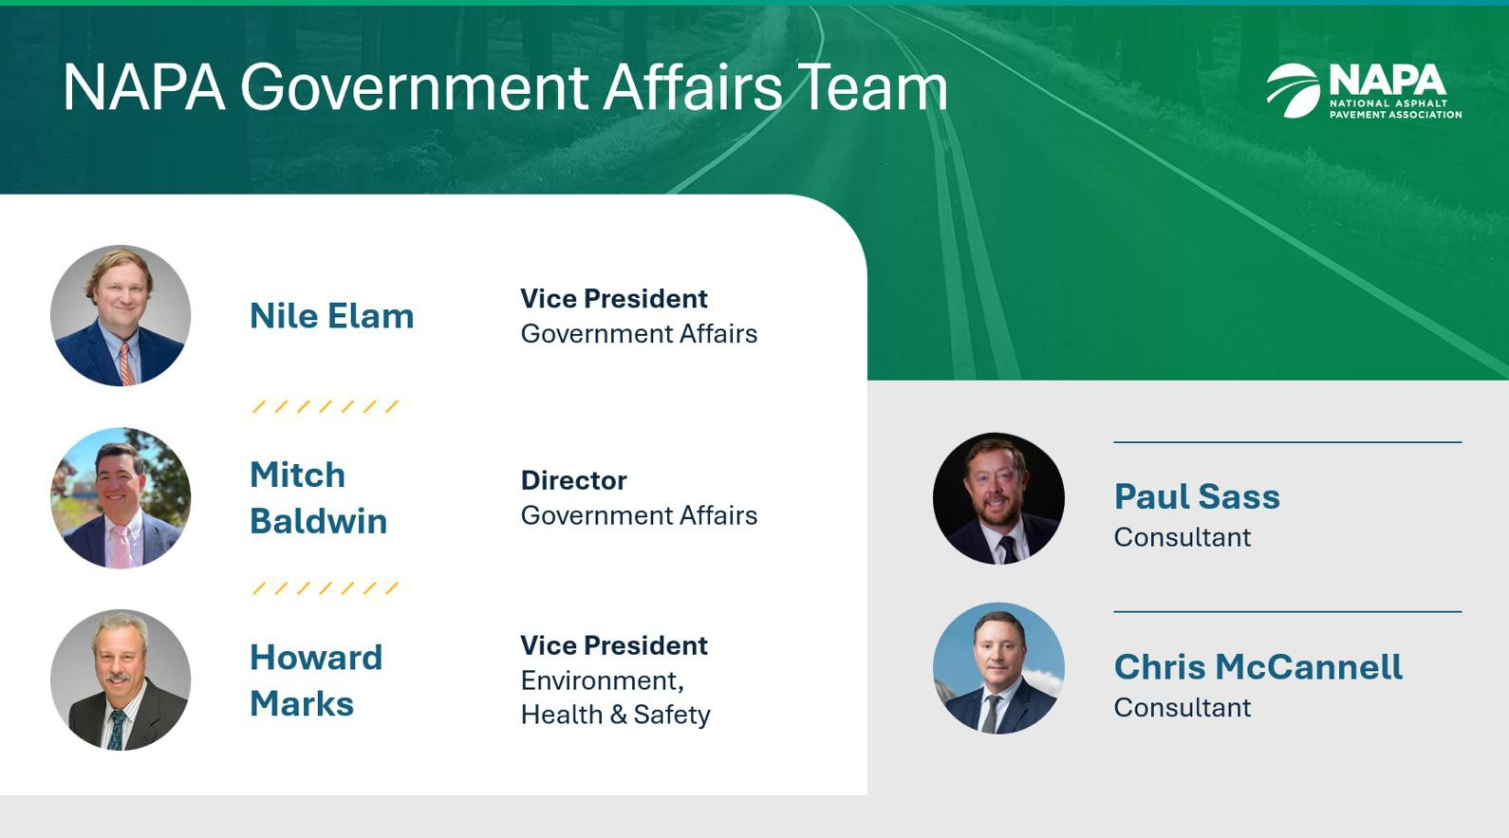
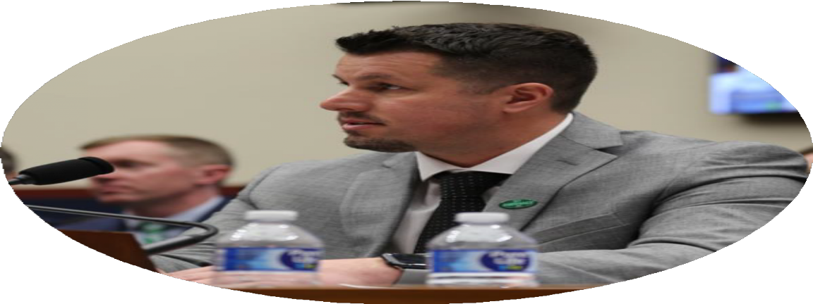


20
Plant tours
Advocacy 2024 Milestones
14
States
$150k
Raised
140
₅₅ NAPA Members
$140k
Distributed
MOC
at Hill Day
meetings
at Hill Day
© 2025 National Asphalt Pavement Association. All Rights Reserved

Slide 7

30
Plant tours
Advocacy 2025 Milestones
13
States
$200K+
Raised
$155K+
Distributed
84
NAPA Members at Hill Day
123
MOC
meetings
at Hill Day
© 2025 National Asphalt Pavement Association. All Rights Reserved

Slide 8
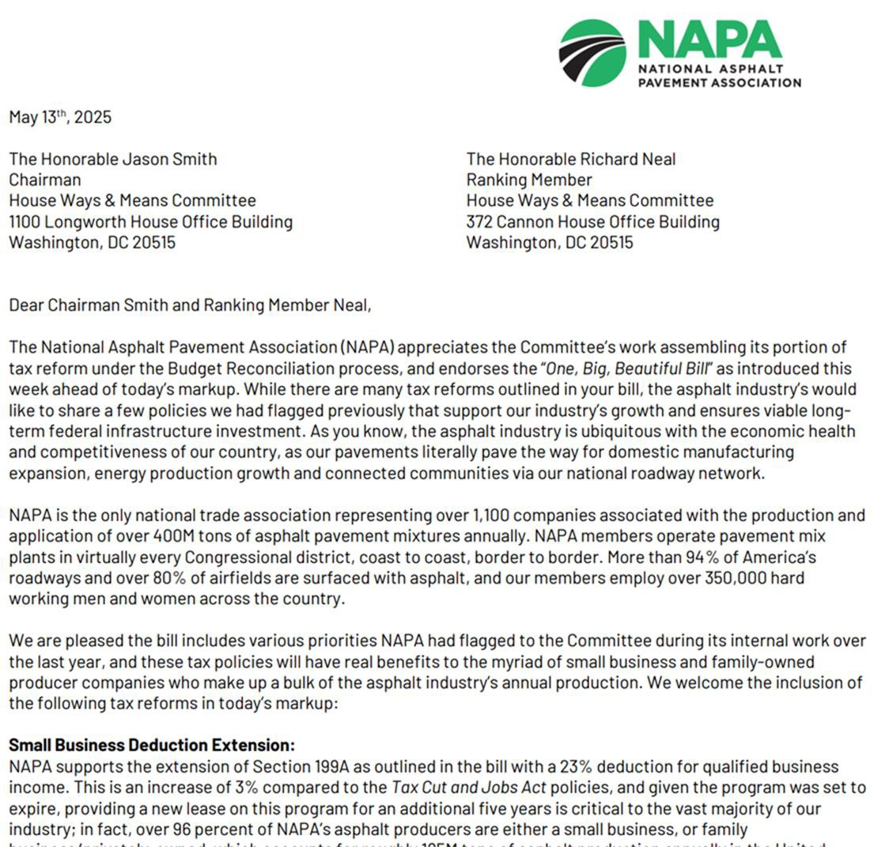
Tax Reform Via One Big, Beautiful Bill
This summer Congress passed the OBB via budget reconciliation regarding various tax reforms
  Builds upon the Tax Cut & Jobs Act from 2017 under Trump 1.0
NAPA led on various items benefitting asphalt producers; including Section 199A reform, extension of R&D tax
credits, updating “death” tax and bonus
deprecation
Biggest bill out of the 119th Congress to
date
© 2024 National Asphalt Pavement Association. All Rights Reserved
8

Slide 9
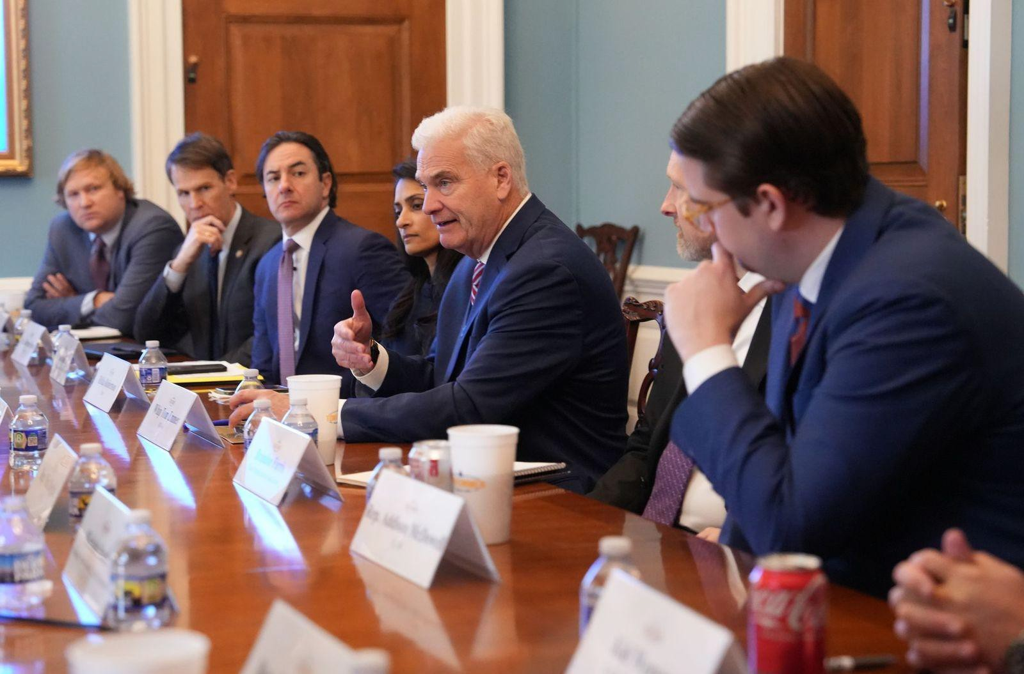
Permitting Reform Passes House Before EOY
SPEED Act
Addresses NEPA processes and reviews
by:
  Limiting scope of EA and EIS review
  Providing certainty by stopping federal agencies from withdrawing documents without a court order
  Limiting duplicative reviews by local/state and
federal government
  Limiting the window opponents can sue
PERMIT Act
  Addressed CWA process and reviews by:
    Simplifying permitting processes for
mining and energy production
    Excludes certain water bodies from CWA protections
    Provides clearer guidelines to permitting agencies
© 2024 National Asphalt Pavement Association. All Rights Reserved

Slide 10
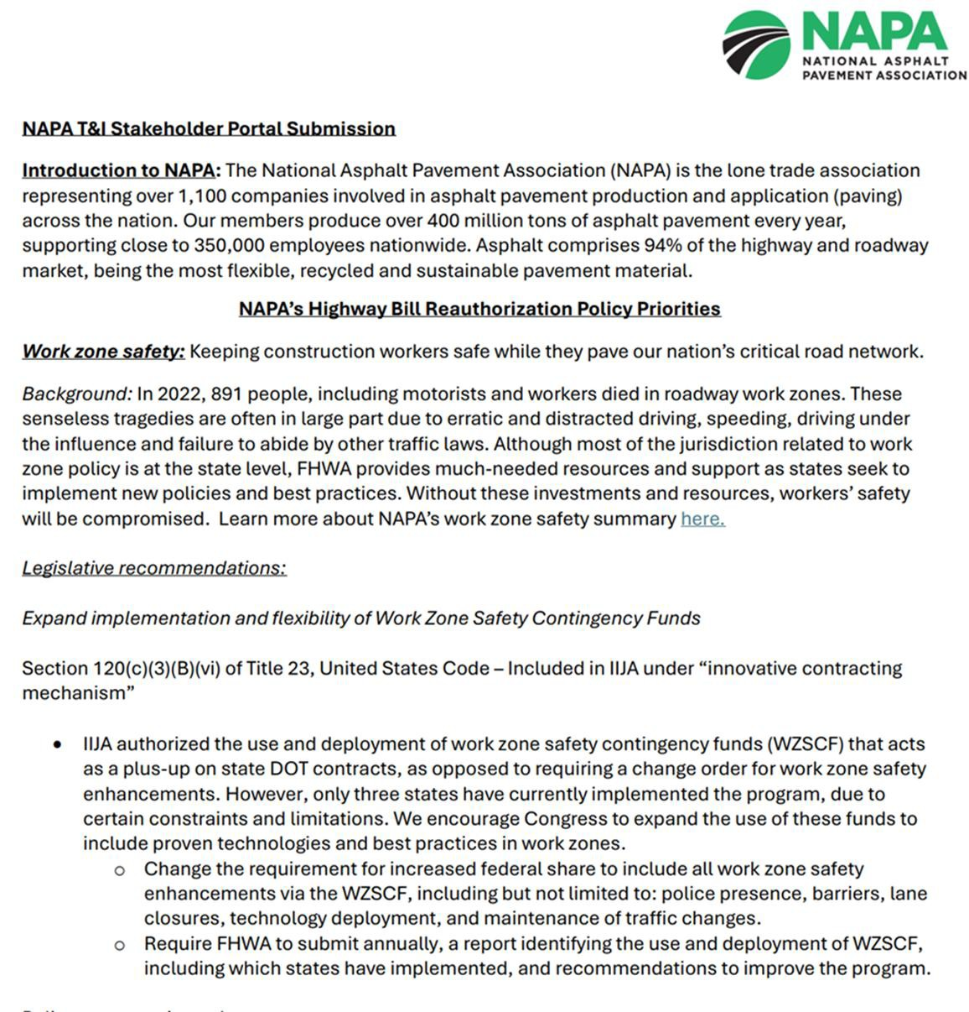
Where Surface Transportation Reauthorization Stands
IIJA will expire September 30th, 2026 – less than a year out
  Roughly $350B is the “floor”
  90% distributed via state formula funds
NAPA has been working on our priorities since mid-2024 – submitted policy priorities to House T&I, Senate EPW and DOT
  Testified before T&I in April
We hope to see T&I’s package sometime in
early Q1 – perhaps by mid-February
  TBD on Senate – likely by Q2 – but T&I has finalized certain titles by EOY
  Senate has 3 Committees to juggle
© 2025 National Asphalt Pavement Association. All Rights Reserved

Slide 11
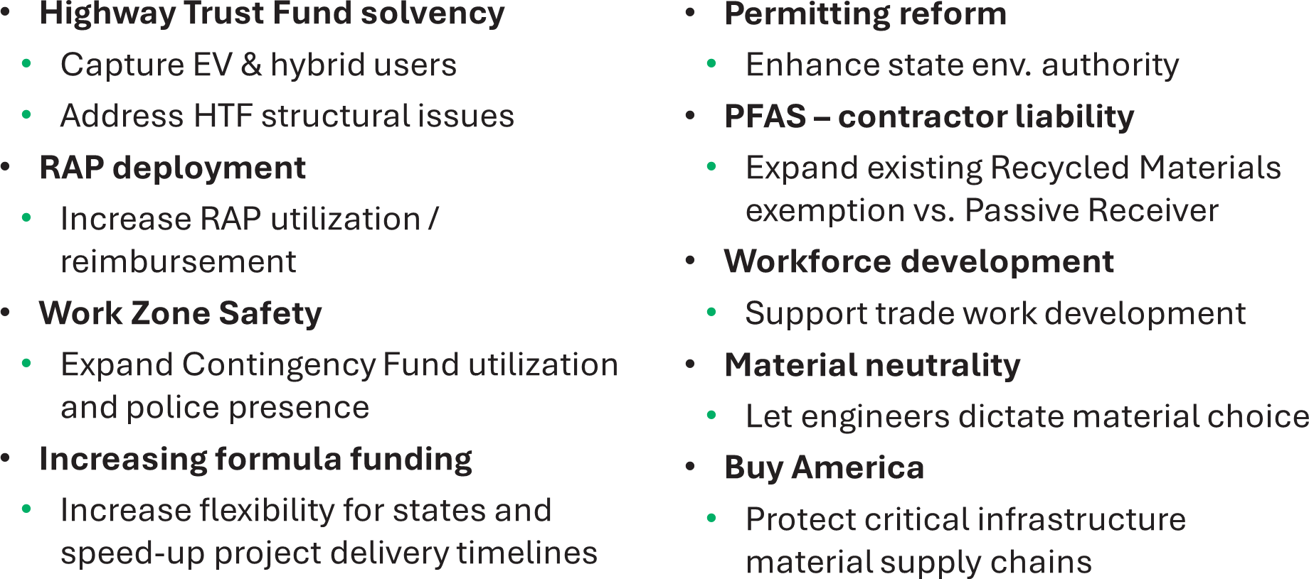
NAPA’s Key Surface Reauth. Legislative Priorities
© 2025 National Asphalt Pavement Association. All Rights Reserved

Slide 12
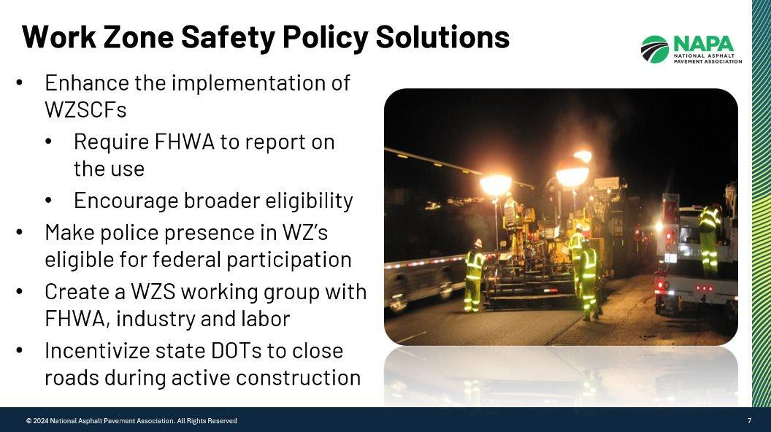
© 2025 National Asphalt Pavement Association. All Rights Reserved

Slide 13













Coalition Partners
© 2024 National Asphalt Pavement Association. All Rights Reserved
13

Slide 14

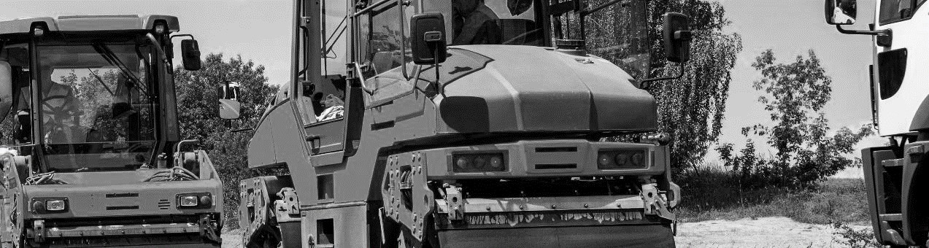


HTF Funding Timeline
Milestones for Reauthorization
NOW!
2025
T&I Committee Engagement
Senate EPW Outreach
SEPTEMBER
2026
IIJA Authorization Expires
SEPTEMBER
2027
Formula Funding Runs Dry
FISCAL YEAR
2028
Highway Trust Fund Insolvent
$250 BILLION
Next 10 Years
Required to maintain existing funding levels
© 2025 National Asphalt Pavement Association. All Rights Reserved
14

Slide 15
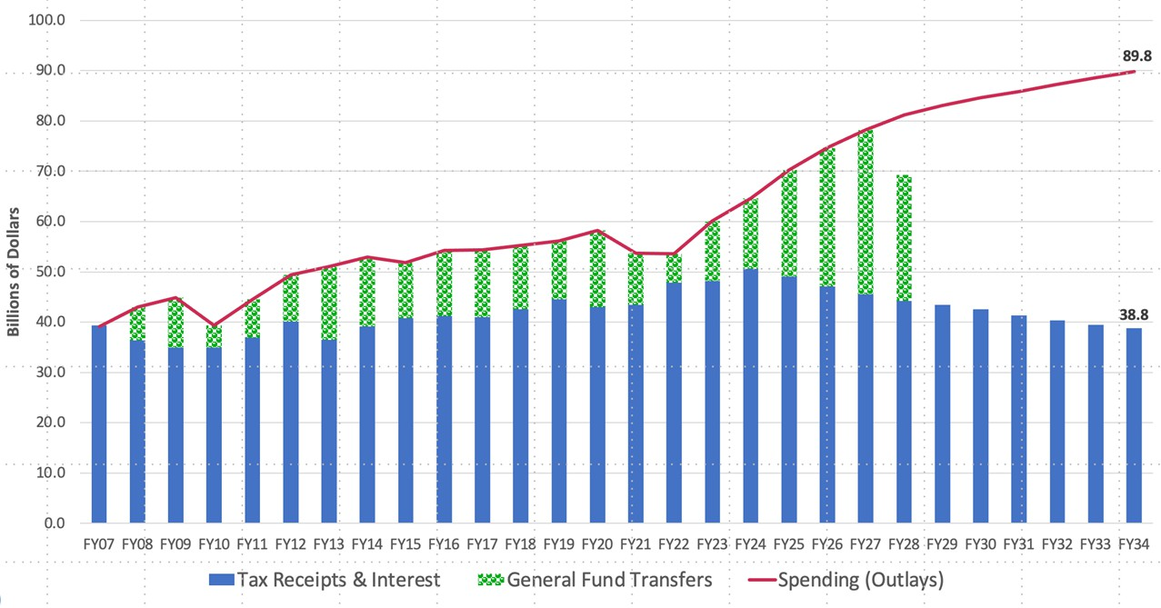

HTF: FY 2007-2023 Actual, FY 2024-2034 CBO 6/24 Baseline
General Fund transfers shown in the year the transferred funds are spent / Source: Eno Center for Transportation
© 2025 National Asphalt Pavement Association. All Rights Reserved

Slide 16
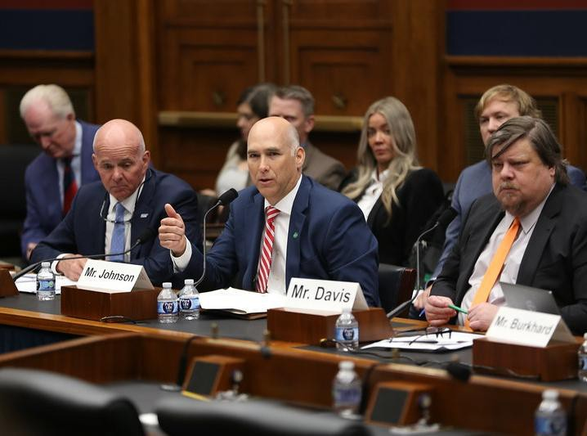

4-6 Images
Ty Johnson, Fred Smith Company, Congressional testimony, April 29 Transportation & Infrastructure Subcommittee on Highways
Watch the highlights
© 2024 National Asphalt Pavement Association. All Rights Reserved
16© 2025 National Asphalt Pavement Association. All Rights Reserved

Slide 17
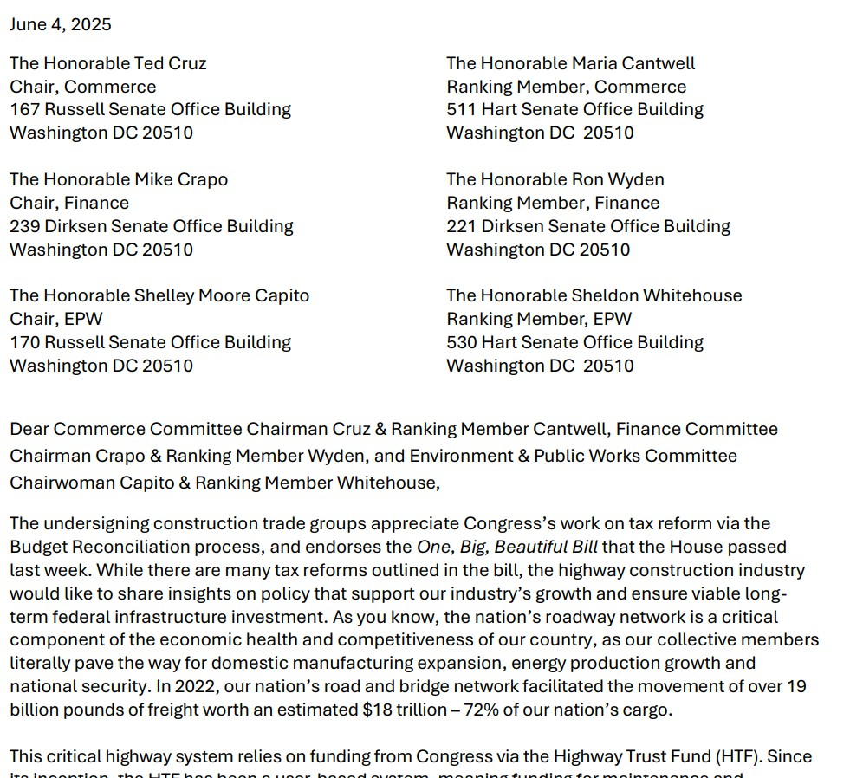
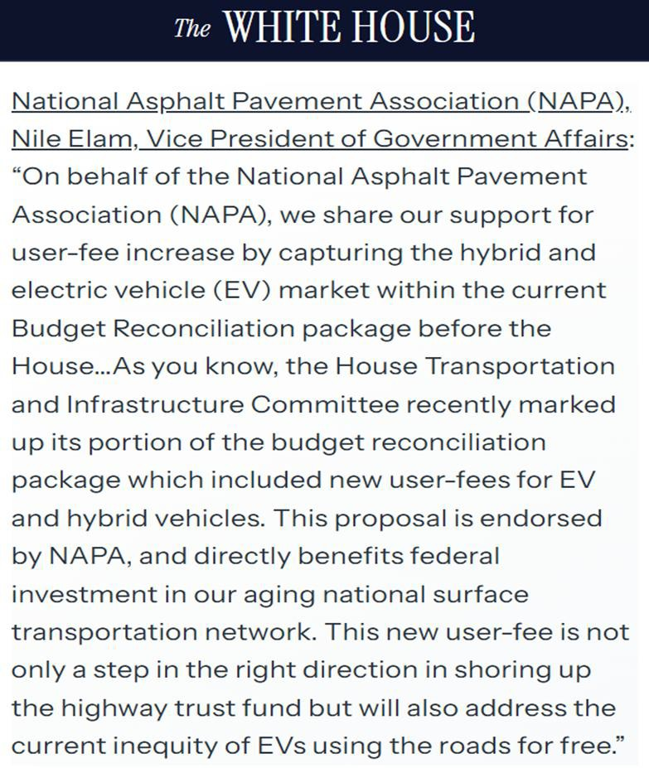
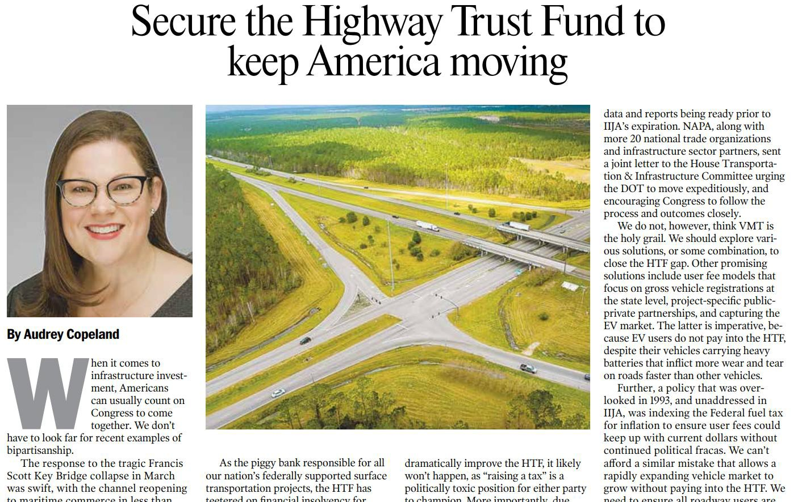
₄N₋A₆P_{I}A_{m}is_{a}le_{g}a_{e}d_{s}ing the push on HTF solvency with the White House and Congress…
© 2024 National Asphalt Pavement Association. All Rights Reserved
16© 2025 National Asphalt Pavement Association. All Rights Reserved

Slide 18
Estimated Total Asphalt Mixture Production
Millions of tons
500.0
450.0
400.0
350.0
300.0
250.0
200.0
150.0
100.0
50.0
0.0
2009 2010 2011 2012 2013 2014 2015 2016 2017 2018 2019 2020 2021 2022 2023
Source: NAPA IS-138
© 2025 National Asphalt Pavement Association. All Rights Reserved
18

Slide 19
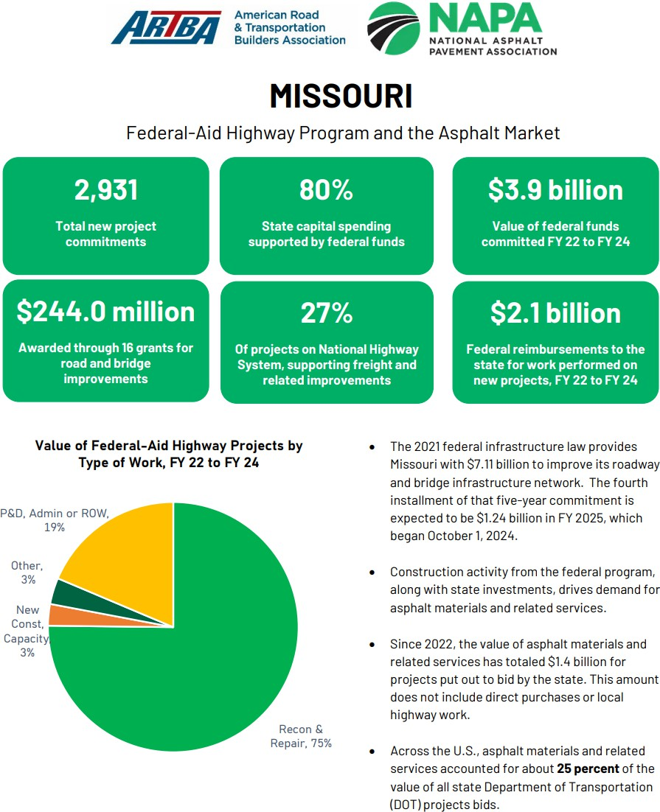
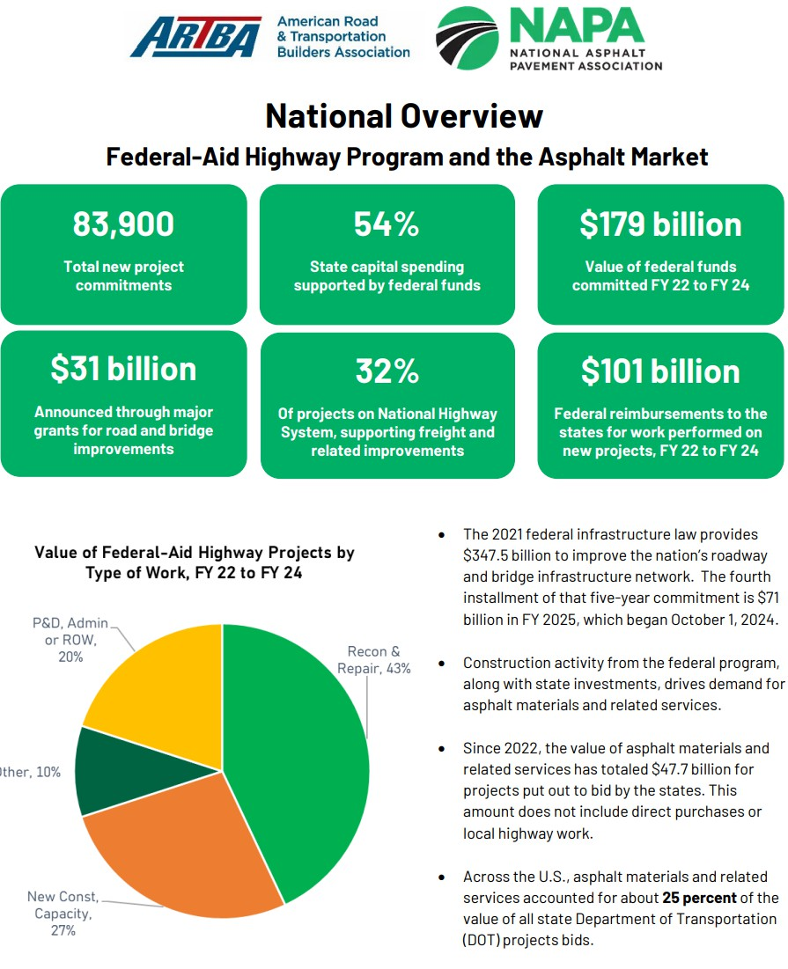
Asphalt Market In Missouri & Nationally
© 2024 National Asphalt Pavement Association. All Rights Reserved

Slide 20
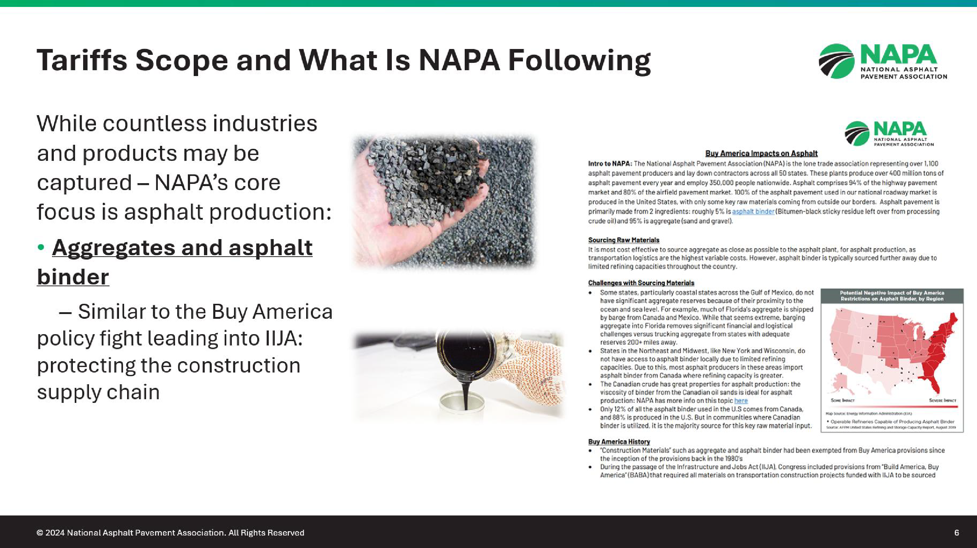
© 2025 National Asphalt Pavement Association. All Rights Reserved

Slide 21
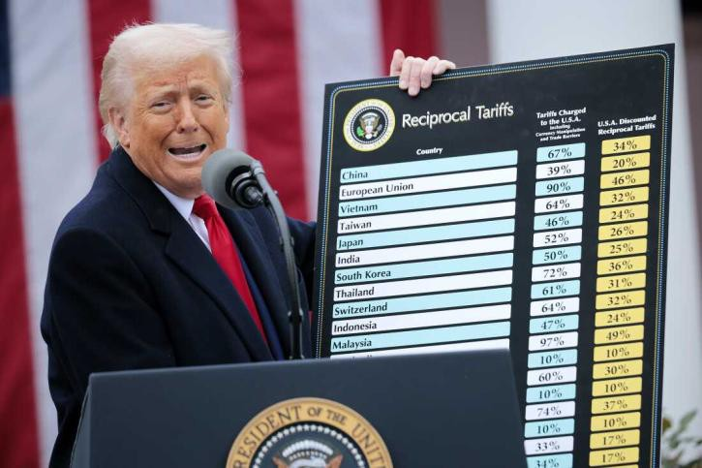
Trump’s Goal Regarding His Tariffs
Potentialy raise upwards of two trillion or more
A “backdoor” approach to revenue raisers
Trump has a 50% tax on steel, aluminum and copper
SCOTUS currently reviewing Presidential powers on tariffs
  Debate between Congress and the White House – Congress usually holds authorities on revenue raisers and “purse strings”
  Trump using tariffs under the International Emergency
Economic Powers Act (IEEPA) and “emergency powers” over foreign trade deficits
  Many think SCOTUS will overrule some of these tariffs
© 2024 National Asphalt Pavement Association. All Rights Reserved
21

Slide 22
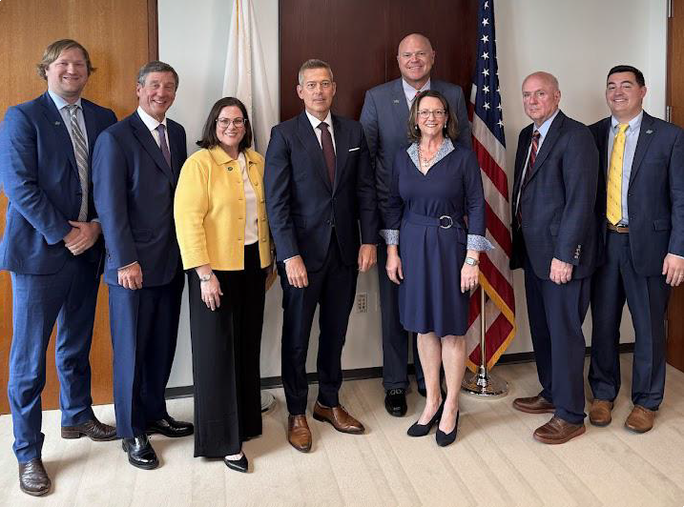
4-6 Images
NAPA meeting with
U.S Department of Transportation Secretary Sean Duffy in June and July
© 2024 National Asphalt Pavement Association. All Rights Reserved
22© 2025 National Asphalt Pavement Association. All Rights Reserved

Slide 23
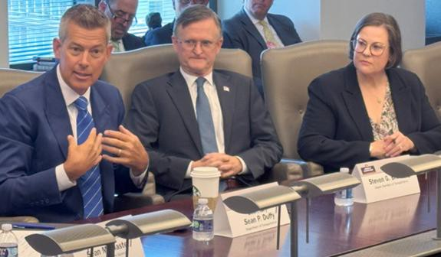
NAPA & Sec. Duffy’s DOT Under Trump 2.0
NAPA has had multiple meetings with the Secretary and his team since January
  Beginning with his transition team, policy team, career staff, etc.
Sec. Duffy wants to see funds going to “turning dirt” and as little as possible to lawyers, consultants, duplicative reports, etc.
DOT solicited their RFI in early fall, plan to release formal policy recommendations in the near future
FHWA Administrator Sean McMaster will join NAPA in Scottsdale later this month
© 2024 National Asphalt Pavement Association. All Rights Reserved

Slide 24


EH&S / Regulatory Affairs
o Protect our people and the environment
Advocate for realistic regulation
Assist industry/members with managing risk & compliance
Appropriately support environmental regulatory reform
  Carbon | focus on WOTUS, TSCA, and permitting – SPEED/PERMIT Act
PRIORITIZE Work Zone Safety & FACILITATE Heat Illness Prevention
Address, assist, and guide industry re Chlorinated Solvents Ban
  Asphalt exemption NOT extended but changes in overall rules are likely
Manage NIMBY / EJ Impacts on Zoning & Permitting
Advocate for PFAS ‘passive receiver’ liability relief
  Superfund Recycling Act & research findings
© 2025 National Asphalt Pavement Association. All Rights Reserved
24

Slide 25




Funding National Advocacy – Support NAPA PAC!
$200,000+
Raised in 2025
30+ Plant Tours
Secured in 2025
405 Members
Political Advocacy Member Council
PAC GOAL
$250,000
JOIN TODAY
© 2025 National Asphalt Pavement Association. All Rights Reserved

Slide 26
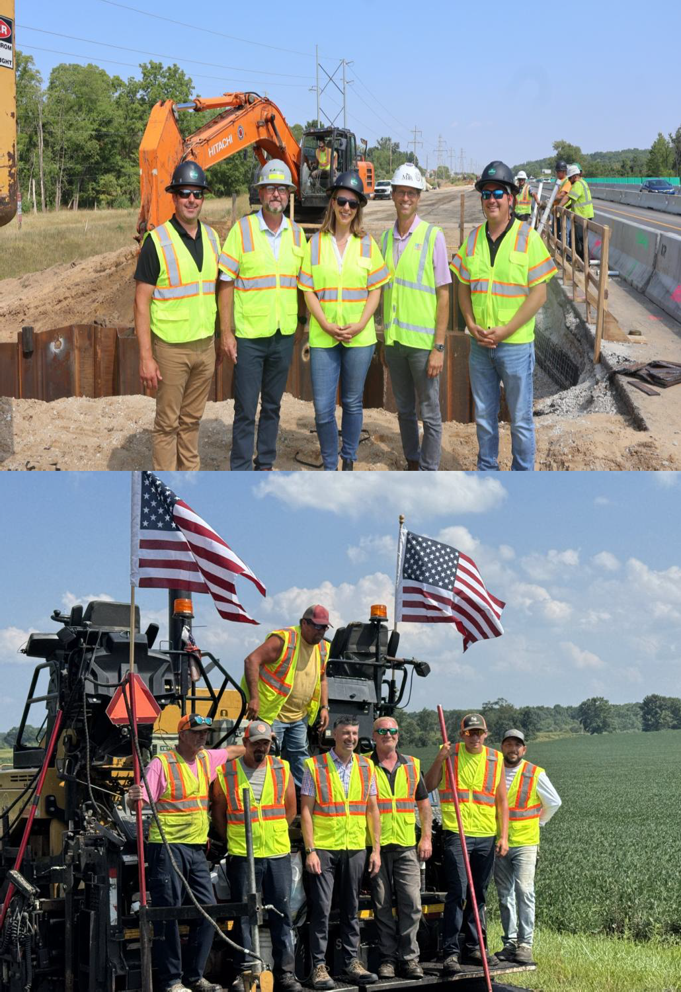
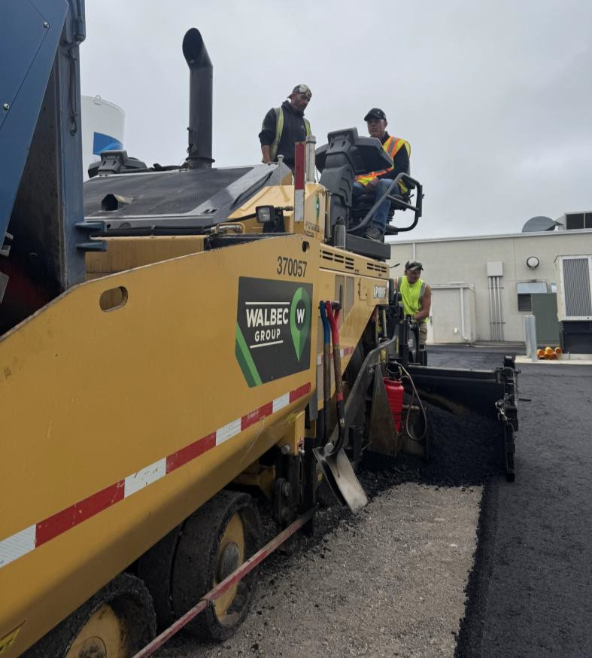
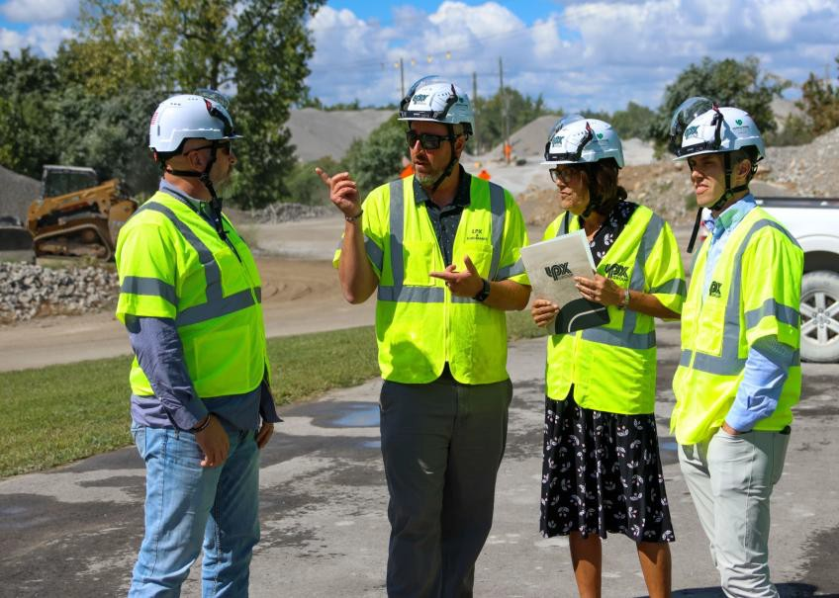
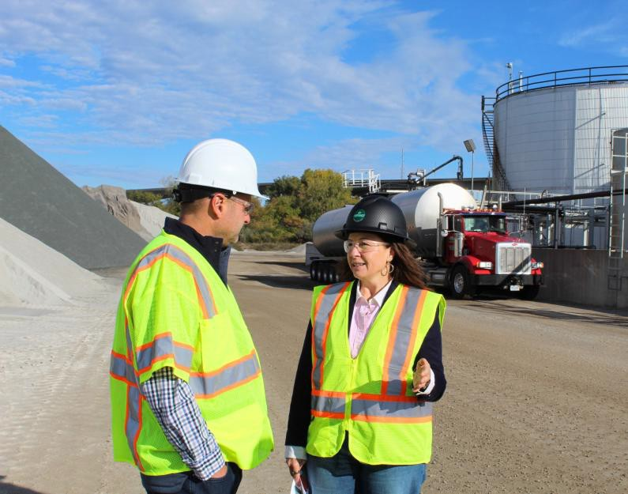
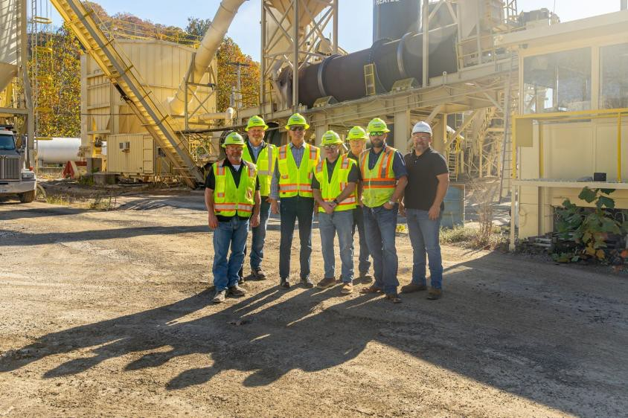
© 2025 National Asphalt Pavement Association. All Rights Reserved

Slide 27




TAKE ACTION NOW!
Join NAPA’s Political Advocacy Member Council and Legislative
Committee
Contact your Representatives about highway reauthorization
Join us for our next PAC event – NAPA Annual, Jan. 27 in Scottsdale, AZ
Attend our next Hill Day in September
© 2025 National Asphalt Pavement Association. All Rights Reserved
27

Slide 28
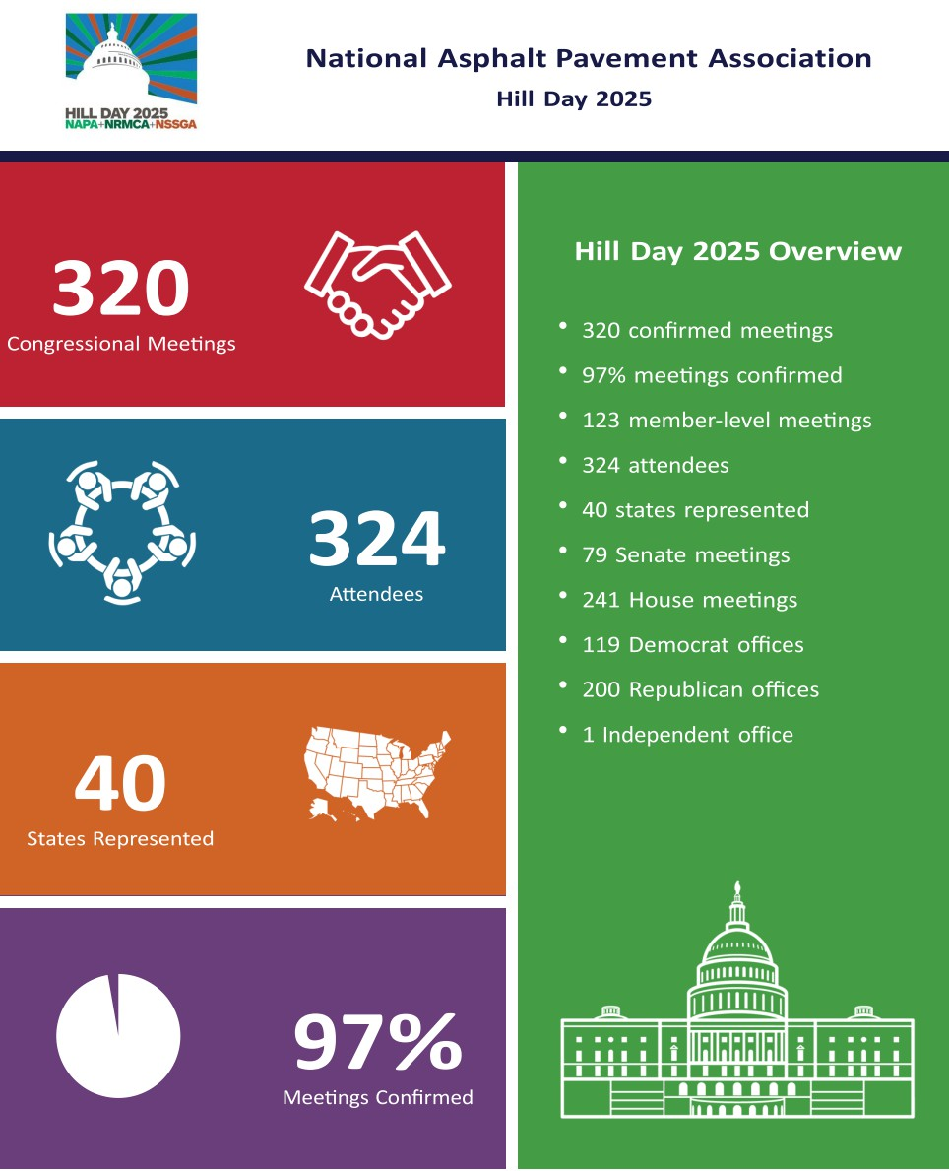
Why You Need To Be At NAPA Hill Day In September
IIJA will expire September 30th, 2026 – we could be voting for passage of the next highway bill during Hill Day 2026
NAPA schedules all of your meetings and provides custom Hill Day app to your track meetings, talking points, material, etc.
We give you your Hill Day collateral, provide special guest speakers and HH events, PAC receptions
We will have a highway bill to point to, rally support and urge its passage before the 119th Congress adjourns
Get involved now – NAPA GA can help!!!
© 2025 National Asphalt Pavement Association. All Rights Reserved

Slide 29

Thank you! Questions?
© 2024 National Asphalt Pavement Association. All Rights Reserved

