Slide 1


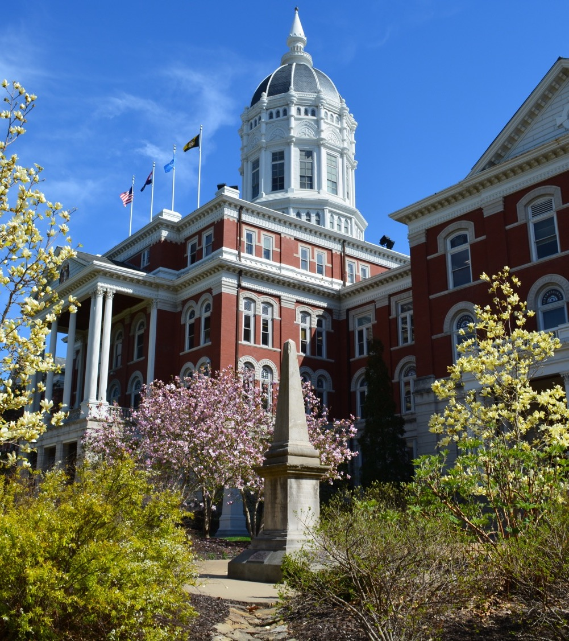
Update on Mizzou Asphalt Pavement & Innovation Laboratory
Presented at 2026 MAPA Annual Conference
Columbia, MO
Punyaslok Rath
Assistant Research Professor
Bill Buttlar
Glen Barton Chair of Flexible Pavements
Department of Civil and Environmental Engineering
University of Missouri, Columbia
01/06/2026

Slide 2

Advancing asphalt innovation, generating game-changing new materials, and developing AI-based infrastructure solutions

Slide 3
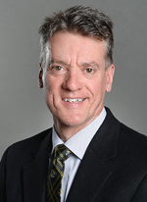
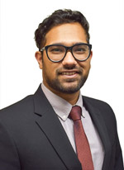

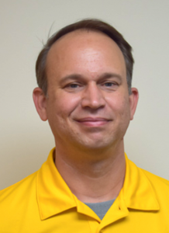
Senior Staff
Bill Buttlar
Professor
Pioneer in Asphalt Innovation, Pavement Engineering, and AI-Driven Sustainable Infrastructure
Punya Rath
Asst. Professor
Recognized Expert in Asphalt Recycling and Material Characterization
Ahmed Mohamed
Asst. Res. Professor
Expert in Asphalt and Recycled Materials Structural Modeling
Jim Meister
Lab Manager
25+ Years of Experience in Asphalt Materials and Field Operations

Slide 4





Graduate Researchers
Helmut
Leodarta
Ph.D. Student
Asphalt Chemist and Innovative Asphalt Additive Specialist
Nandita
Gettu
Ph.D. Student
Life Cycle Assessment (LCA) and Sustainable Paving Materials Expert
Ashkan
Behzadian
Ph.D. Student
Machine Learning and Pavement Data Scientist
Fatemeh
Kazembab
Ph.D. Student
Rubberized Asphalt and LCA Researcher
Anneliese
Owor
MS Student
Innovating Airport Asphalt Materials

Slide 5
Proposals in 2025
10 proposals written
Federal agencies – NSF, NCHRP
State DOTs – MoDOT, MnDOT
Others – NAPA (Airports Pavement Research Program)
Pooled Fund Study
Total funding we went after ~ $4 million

Slide 6
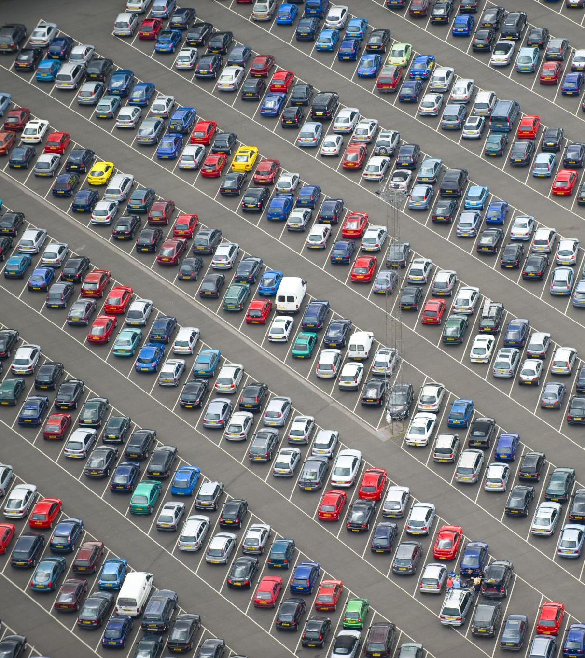
Project Spotlight: Pooled Fund Study
Establishment of a Public-Private Transportation Data Exchange Center
Collecting vehicle data from OEMs relating to transportation infrastructure, including pavement condition data
Support from: CA, CT, HI, KS, MO, NJ, PADOT, TX, WI
Total commitments received: 1.65 million

Slide 7
Project Spotlight: Frictional Properties of BMD Mixtures
Evaluating seven mixtures to be constructed on I55
Partner – Missouri S&T (Dr. Magdy Abdelrahman)
Focus on incorporating friction assessment into BMD
Other aspects include:
Evaluation of HiMod mixtures
Evaluation of GTR with and without fibers
BMD benchmarking for SMA mixtures

Slide 8
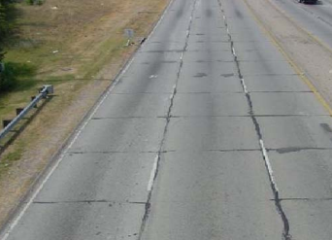
Project Spotlight: Reflective Cracking Challenge
Part of national study funded by the National Road Research Alliance (housed at MnDOT); MoDOT is a key stakeholder
Evaluating I155 mixtures and sections with a focus on mitigation of reflective cracking
Other partners include: NCAT Test Track, MnROAD facility, UNH, Heritage Group
Modeling of reflective crack propagation through asphalt overlays
From Von Quintos et al. 2010

Slide 9
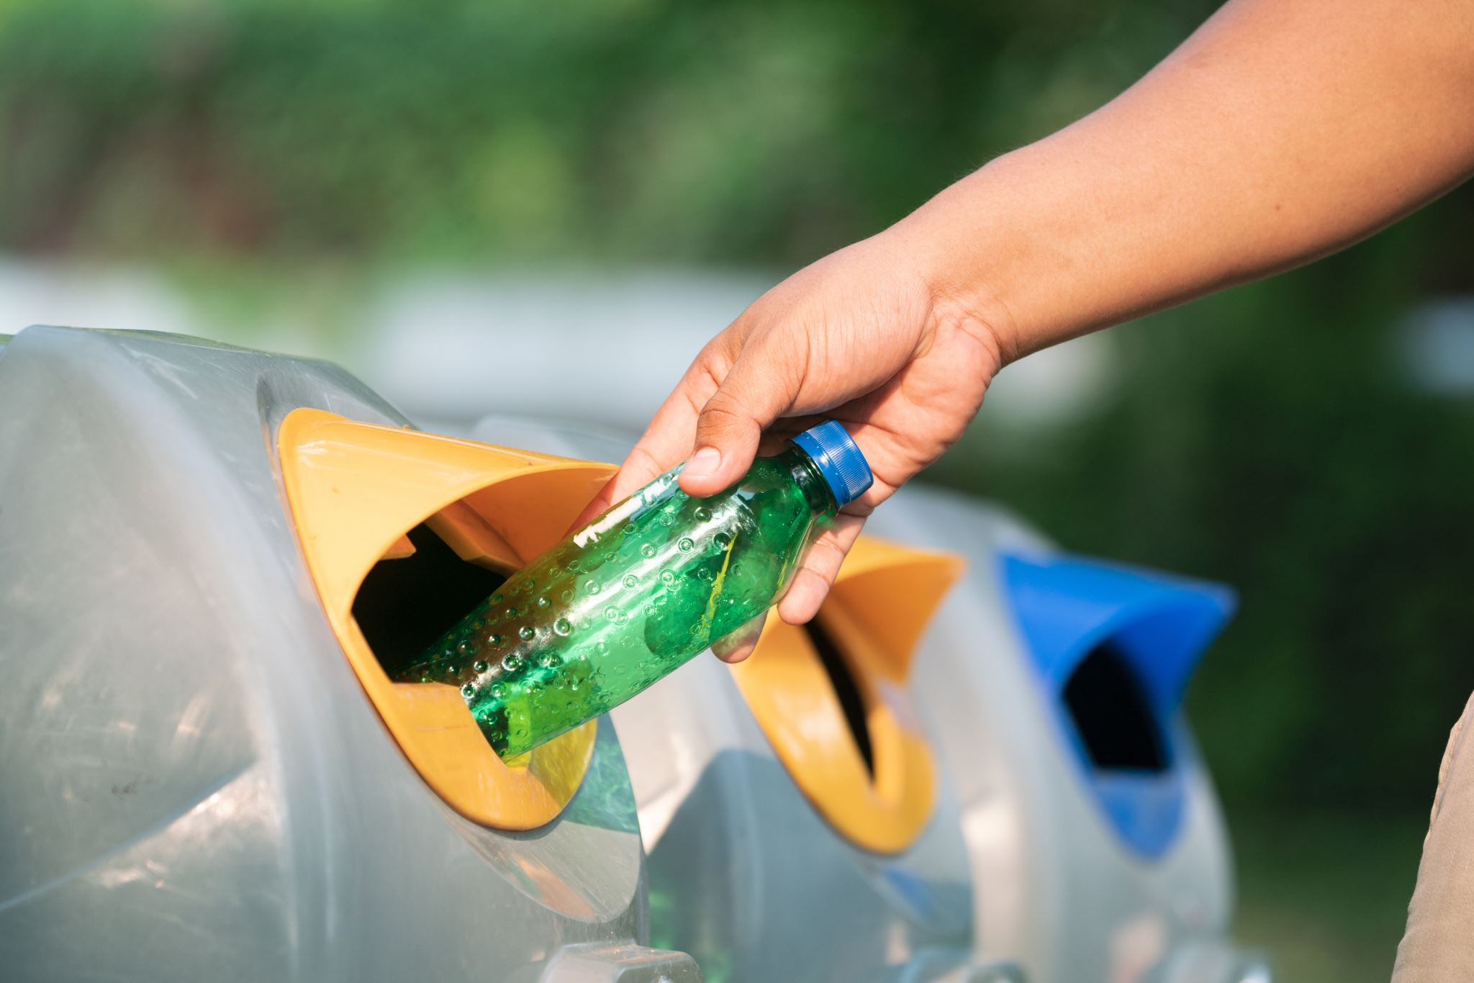
Project Spotlight: Waste Plastic-Based Asphalt Additive
Funded by NSF-backed Mizzou TecHub under the Accelerating Research Translation program
Taking unwanted waste plastics and engineering them into pellets
Sourcing plastics from local sources
Patent-pending proprietary innovation
Looking for partners to build test sections in 2026

Slide 10
Looking Ahead: 2026
Three proposals to be submitted in Jan 2026
Continue cutting-edge research
Grow strategic partnerships for federal funding
Target another University Transportation Center (UTC) in state
MCTI’s TRB Reception

Slide 11
